Slide 1

Home Energy Ratings & Disclosure
Insights from a real estate sector engagement
Version 1.1
November 2024
Prepared for:
NSW Department of Climate Change, Energy, the Environment and Water
Prepared by:
Biome Studios

Slide 2

Disclaimer
This report was prepared by Biome Studios with care and in good faith. However, we do not guarantee its relevance, accuracy, completeness, or suitability for any specific purpose. Users should assess whether the information applies to their situation and seek expert advice if needed. The views in this report are those of the authors and may not reflect the views or policies of the Department of Climate Change, Energy, the Environment and Water.
© Copyright State of NSW and the Department of Climate Change, Energy, the Environment and Water.

Slide 3

Acknowledgment of Country
The work in this project took place on
multiple traditional lands of Aboriginal and
Torres Strait Islander peoples.
This work relates to reducing the impact of
residential properties on the environment. It
acknowledges the deep wisdom, connection
and knowledge of elders past, present and
emerging leaders in co-existing with nature.
We acknowledge their ancestral spirits with
gratitude and respect.

Slide 4
Contents
1. About this work Page 6
2. Approach Page 12
3. Key themes identified Page 15
4. Details of key themes Page 21
5. Additional stakeholder findings Page 42
6. Appendix Page 57

Slide 5

Find what you're looking for
Insights overview (05 min) Page 14 – 20
Project overview (15 min) Page 07 – 20
Detailed insight (30 min) Page 15 – 41
Summary of materials used
in research sessions Page 57 – 78

Slide 6
1. About this work
This section includes the executive summary, an overview of key themes, and the policy context for home energy ratings.

Slide 7
Executive summary
This report, compiled by the Sustainable Homes team at NSW Department of Climate Change, Energy, the Environment and Water (DCCEEW) in collaboration with Biome Studios, consolidates insights from consultations with real estate agents (RE agents), property technology (Proptech) stakeholders, and participants at the 2024 Proptech Forum.
This work was conducted on behalf of the Australian, state and territory governments. It explores the challenges, drivers, and opportunities for the real estate sector to integrate home energy ratings as part of their systems and processes when residential properties are being put on the market for sale or lease.
This report underscores the importance of an integrated, user-focused approach to implementing home energy ratings disclosure. By addressing the themes detailed in this report, we can increase and enable the adoption and impact of home energy ratings, fostering a more energy-efficient housing market across Australia.

Slide 8
Overview of key themes identified
1. Educate and prepare stakeholders
Training RE agents early is key to successfully introducing home energy ratings. Mandatory training on regulations, delivered with well-known real estate professionals during quieter times, would help increase awareness and use. It's also important to inform buyers. Buyers are more likely to use energy ratings when they see them as a way to find value, negotiate, or plan upgrades for their new home. Engaging buyers will encourage RE agents and sellers to take action.
2. Streamline and orchestrate adoption
Home energy ratings need to clearly explain the process, costs, how long they last, and when reassessments are needed. The rollout of technology, training, and policies should match how ready stakeholders are. Tools, consumer education, financial incentives, and skilled tradespeople should be available when consumers are ready to make upgrade decisions.
3. Ensure clarity and consistency
Standardisation is key to building trust, bringing stakeholders together, and driving change. Stakeholders highlighted the importance of using consistent formats for certificates, icons, and data to ensure clarity and confidence for consumers. Disclosure policies should balance transparency with business needs while staying fair. Clear and simple communication will help avoid confusion or negative reactions to introducing home energy ratings in Australia.
4. Provide tangible, actionable information
Ratings need to show their value clearly. Comparing metrics, highlighting costs and savings, and explaining lifestyle benefits can help users understand and take action. Providing details on how upgrades improve ratings can guide homeowners to make smart choices and improve their home's energy performance.

Slide 9


Policy landscape of home energy ratings
Most of Australian homes are uncomfortable to live in and expensive to operate.
Australia has a home energy performance problem, with an estimated 80% of existing homes rated at two stars or less under the Nationwide House Energy Rating Scheme (NatHERS).
This inefficiency contributes to significant issues, including unhealthy living conditions—cold homes alone account for 6.5% of deaths annually—and increased energy costs for households.
With residential homes responsible for 24% of Australia's electricity use and 11% of greenhouse gas emissions, addressing home energy performance is critical to achieving the nation's net-zero targets and providing safe and livable homes for all Australians.
*Figures from Home Energy Ratings Disclosure Framework
​Australian governments are committed to increasing the energy performance of existing homes across Australia.
Under the Trajectory for Low Energy Buildings, the Commonwealth, state and territory governments have committed to transition the residential sector towards a net zero and carbon ready future.
Two key residential initiatives under the Trajectory include:
Deliver a home energy rating framework for existing homes, which leverages the Nationwide House Energy Rating Scheme (NatHERS) framework
Establish a national framework for energy efficiency disclosure that provides nationally harmonised home energy rating disclosure settings and parameters, which state and territory governments can implement in their jurisdiction.

Slide 10

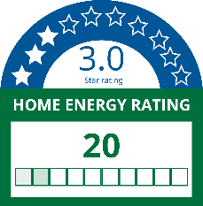
Landscape of home energy ratings
Home energy ratings are coming for existing homes.
By mid-2025, home energy ratings will be available across Australia for all homes, not just new properties.
Like the rating available on appliances, a home energy rating will make the energy performance of a home and its related costs more visible to consumers. It will also enable consumers to compare between properties when buying or renting. The ratings represent estimated annual energy use for a property based on key property features, such as building materials, windows and main appliances.
These ratings, generated by accredited assessors, will be presented on a Home Energy Rating Certificate. The certificate will also provide useful information on upgrade opportunities, encouraging energy performance improvements of the property.
Benefits of home energy ratings.
As the cost of living continues to soar, many householders are turning their attention to better energy performing homes. These properties are gaining popularity not just for their environmentally friendly features, but also for the significant impact they can have on reducing day-to-day living expenses and improved comfort. ​
Home energy ratings are a powerful tool to make the energy performance of a home tangible and to inform large and important investment decisions. Data indicates that 59% of consumers consider energy efficiency ratings crucial when buying, renting, or building a home.
​Data indicates that vendors will also benefit from increased interest in their home and quicker sales times for higher performing homes​.

Slide 11


Landscape of this work
Application of home energy ratings.
Energy ratings are already widely adopted for new homes across Australia to demonstrate compliance against the National Construction Code. Making energy ratings publicly available is also common practice in the commercial building sector in Australia, with the Commercial Building Disclosure Program requiring National Australian Built Environment Rating System (NABERS) ratings to be disclosed for office buildings.
Once home energy ratings for existing homes are available mid-2025, state and territory governments can decide to make ratings mandatory when a property is being advertised for sale or lease.
The Australian Capital Territory has successfully operated a mandatory scheme since 1999. NSW has recently committed to mandatory disclosure implementation, beginning with the delivery of trials in 2025.
Ensuring the introduction of ratings is fit-for-purpose
The real estate sector is a natural key partner in the introduction of home energy ratings, due to the central role they can play when a property is being sold or leased. ​The sector could influence the use and response to home energy ratings uptake. ​
It is essential to ensure the sector is ready to assist and support customers to meet their needs and aspirations. Working with the sector early in the policy process will minimise disturbance and ensure home energy ratings are well understood and adopted.
As a result, the NSW Government has been engaging the real estate sector, including the Proptech industry. This engagement was undertaken on behalf of the Commonwealth, state and territory governments. The aim of the engagement was to understand opportunities and barriers to introducing home energy ratings and to identify key design principles to meet consumer and industry needs.

Slide 12
2. Approach
This section explains how we explored the opportunities and challenges of introducing home energy ratings.

Slide 13
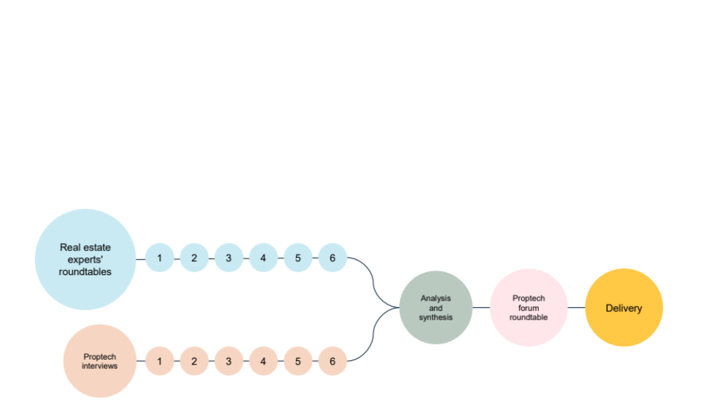
Engagement overview
Biome Studios, in collaboration with NSW DCCEEW, conducted 6 real estate expert roundtables and 6 Property Technology (Proptech) interviews in parallel.
Once these sessions were completed, analysis and synthesis was conducted to uncover key insights and findings.
These were then shared for feedback and engagement at the Proptech forum, organised in November 2024 by Proptech Australia, before this final report was written.
Engagement sessions covered:
RE agent Resources and Materials
RE agent Professional development and learning
RE agent Home energy rating pitches
Proptech listings
Key messages
Draft advertising rules

Slide 14


Participants overview
58
Participants were recruited through networks held with NSW DCCEEW, professional recruitment services and self selected attendance at the Proptech forum. Participants are representative of the leading edge of RE agents and Proptech, representing early adopters and industry influencers.
Stakeholders
19 Real estate agents ​
13 Proptech participants
26 Proptech forum participants
Locations:
NSW
VIC
QLD
WA
SA
Roles:
Property Managers ​​
Sales Agents ​​
Buyer agents ​​
Principals ​​
State partners​
Directors ​​
CEOs​​
CRM providers ​
Listings platforms

Slide 15
3. Key themes identified
This section explains the 4 connected themes we identified
15

Slide 16




How identified key themes relate
To successfully implement a home energy rating policy, four connected themes must work together to ensure it is adopted and makes an impact.
For example, educating real estate agents (Theme A) works better when the government leads the rollout and simplifies decisions (Theme B). Clear rules and standard formats (Theme C) also help make education and communication (Themes A and D) clear and consistent.
Each theme plays a key role, and together they create the conditions needed for home energy ratings to succeed.
Theme A:
Build the capacity of the market to adopt and respond to home energy ratings through education.
Theme B:
Government needs to be the glue and orchestrate to enable adoption and make decision points easy.
Theme C:
Keep rules and guidance clear, simple and consistent so that competition is fair and information is useful and comparable.
Theme D:
Make information tangible and provide context so that users can make decisions and take action.

Slide 17
Theme A:
Build the capacity of the market to adopt and respond to home energy ratings through education.
RE agents identified early training and capability uplift as crucial prior to launching home energy ratings.
Many RE agents suggested regulation training for home energy ratings should be made mandatory to increase awareness and uptake, especially if making disclosure mandatory.
But the design and delivery of training must be engaging and flexible enough to fit around RE agent's workflows and quiet times like winter and the summer break. Ideally training is co-delivered with a respected and influential real estate figure to encourage uptake and is available during quiet industry periods.
A key leverage point will be raising the awareness of home energy ratings for buyers. Buyer’s questions drive RE agents interest to learn more and sellers to consider upgrades. Buyers generally have larger financial and personal incentives to care about home energy ratings since they directly benefit from the home's energy efficiency for years to come.
Raising vendor awareness and knowledge is also crucial to help reduce a potential backlash and to help frame the rating as an opportunity for a better return on investment. But buyer behaviour will be what drives vendor interest and action.
If buyers are asking questions then agents don't want to sound like a dummy, they will go and do the research to attempt to try and learn something.
- RE agents Upskilling 2
It'll be the new buyers more than likely who will do upgrades because their house doesn't have the features they're after.
- RE agents Resources 1
We are supposed to be knowers of all things, with our clients we need to be able to hold our own and know how their property stacks up against another one.
- RE agents Upskilling 2
You need those people that will bring people into the fold, get that critical mass, push it over.
- RE agents Upskilling 1

Slide 18
Theme B:
Government needs to be the glue and orchestrate to enable adoption and make decision points easy.
The home energy rating process and service journey should be made clear to set expectations and assure agents and consumers of the process. Define the steps, costs, longevity of a rating and requirements for re-assessment.
Rollout of policy, technologies and training needs to be orchestrated to maximise engagement and facilitate ease of uptake.
Make the choice to install energy efficient features easy at key moments like selling and buying a home, or when something breaks, or a disaster like drought or flooding drives change. Government must ensure the infrastructure is in place to support easy decision making. This means ensuring there are trained trades people, educated RE agents, aware consumers and financial supports and incentives in place.
If we're doing some kind of certification, it has to be done by someone who cares. I've seen pool certifications where each certifier has a different opinion about something that should be black and white, compliant or non-compliant.
- RE agents Resources 1
To get this right (delivery of ratings disclosure) could take us 12-18 months.
- Proptech 2
We have training in December, and I asked is there a better time we can do this? There are ebbs and flows, January, winter break. Time of year and speed of the course are important.
- RE agents Upskilling 2
You run into issues with the trades as well. Electricians and plumbers are super resistant to change. It's easier to install another RHEEM than an electrical heat pump.
- RE agents Upskilling 1

Slide 19
Theme C:
Keep rules and guidance clear, simple and consistent so that competition is fair and information is useful and comparable.
Stakeholders identified the importance of clear and standardised rules. Standardised formats for certificates, icons, and data would enable consistency and efficiency across the sector.
Disclosure rules must strike a balance between standardisation and commercial objectives, ensuring consumer transparency without overly restricting business goals.
Careful consideration must be given to the policy about when the rating must be disclosed and if and when the certificate or its data should be disclosed.
The rating icon causes confusion for stakeholders.
The star rating is the most easily understood and prominent but not the key metric recommended for disclosure.
If you say it is standardised and must be presented this way, then people will follow. If you give people the choice they'll all do it how they want to.
- Proptech 2
My initial thought is the higher the star rating, the more energy efficient the house is.
- RE agents Communicating Ratings 2
Needs a standardised format. Make it compulsory.
- RE agents Resources 2
I love that NSW is looking to mandate it.
- RE agents Upskilling 1
I think it’s great that mandatory energy ratings are coming across NSW.
- RE agents Resources 1
On the listings environment it’s a real competition for space.
- Proptech 3

Slide 20
Theme D:
Make information tangible and provide context so that users can make decisions and take action.
Stakeholders indicated a metric or rating without context or a baseline will provide little value to users and be disregarded.
Indicating how a rating compares to others helps users understand the risks and opportunities of their rating. Providing tangible figures like financial or lifestyle impacts motivates users to act.
If users do choose to act, they want to know what impacts each choice or action will have. Specifically, they want to know how each feature upgrade improves their rating.
Financial and lifestyle improvement information is a key motivator that unlocks change and encourages investment in upgrades that improve the energy performance of homes.
Is 60 good or bad? I don't know. Is it cheap to run or expensive to run? It's lacking context.
- Proptech 3
Dollar figures help people be aware of what their savings can be.
- RE agents Resources 1
I don't know how to interpret whether my house is a good house or a bad house. Maybe have a national benchmark or a suburb benchmark or both.
- Proptech 4
Would like confidence that if I take action, my rating will benefit from it.
- RE agents Communicating Ratings 2

Slide 21
4. Details of key themes
This section provides a detailed explanation of each theme's main points.
21

Slide 22
Theme A: Educate and prepare stakeholders
Build the capacity of the market to adopt and respond to home energy ratings through education.
22

Slide 23
Theme A: Main points – 1
A.1 Real estate agents want to be one step ahead of customers
As consumer awareness around home energy efficiency grows, RE agents face pressure to build knowledge. Buyers, increasingly well-informed on energy ratings and efficiency, will drive the need for agents to stay ahead. Effective training and up-to-date knowledge on property features—such as solar panels and energy-efficient appliances— will be important information for some agents to confidently answer detailed questions and gain a competitive edge.
Agents must anticipate buyer inquiries and discuss energy efficiency as they would any other property features, highlighting energy savings, comfort benefits, and the value of specific features. Providing accurate information builds trust and positions agents as credible, influencing both buyers and vendors. If vendors, see the importance buyers place on energy ratings, they may be motivated to make improvements, while buyers could use ratings as negotiation tools.
If buyers are asking questions then agents don't want to sound like a dummy, they will go and do the research to attempt to try and learn something. - RE agents Upskilling 2
For an agent to be able to go in and have a conversation with a client and anticipate their questions about home energy ratings, that’s important. - RE agents Resources 2
I think if we train agents to have the right conversations with their clients, they are going to be seen as a professional, relevant agent in the marketplace. - RE agents Resources 2
The vendor will take note when the buyer is making an issue of it. Vendors will make changes driven by the agent. - Communicating ratings 2
Training is important down the line to be able to clearly define and explain the difference in comfort comparatively across properties based on the features that are included in the properties. Easily attaching that to the benefit of the cost savings. - RE agents Upskilling 2
A.2 Real estate agents as knowledgeable professionals not experts
In situations where customers lack industry or market knowledge, they depend on agents to provide essential information/input about property decisions.
RE agents don’t need to be technical experts but they recognise the role they could play in supporting customers to understand value. RE agents need to be knowledgeable enough to ensure customers are well-informed about the property and potential costs and benefits. By leveraging external experts—such as building assessors in addition to existing experts like mortgage brokers—agents can deliver a comprehensive expert view to their clients, enhancing trust.
Providing the right levels of education and enabling agents to discuss improvements, property attributes and the tangible benefits from those features will position them as knowledgeable professionals or enables them to differentiate from others RE agents.
We hear that people don't trust real estate agents, but they trust themselves even less. They will rely on an agent to understand decisions they want to make about a property. They'll be asking the agent all those questions. - Proptech 3
Trusted advisor - in many instances purchasing or selling a home is the largest financial thing someone is going to do. Sometimes a client can be incredibly well informed and has done a lot of research, but in many instances that's just not the case. They don't have industry or market knowledge, its ultimately our job to bring that knowledge, to educate the client. - RE agents Upskilling 2
On a real estate agents perspective, we just need the means and information to give people to make decisions. - RE agents Resources 1
Our expertise lies in bringing to the table the people with the right expertise. - RE agents Resources 2

Slide 24
Theme A: Main points – 2
A.3 Home energy rating training to set-up real estate agents for success
To effectively promote and integrate home energy ratings in the real estate sector, formalised, possibly mandatory early-stage training is essential for real estate agents. Training should equip agents to understand the regulation and interpret and explain energy ratings effectively, ensuring they don’t mislead clients.
Further education can equip agents to explain the energy performance of properties, focusing on the comfort benefits and potential cost savings associated with energy-efficient features, creating more value add. By making energy efficiency a tangible, understood concept, agents can help drive the market and encourage consumer education.
Information packs, such as pre-listing kits, should also be made available to both buyers and sellers to inform them of recommended upgrades.
Additionally, including administrative teams and property managers in this training could ensure broader implementation across agencies.
I think you've obviously got to front load the training and awareness. - RE agents Resources 1
Would expect it to be mandatory because there’s mandatory CPD training we have to do all the time. - RE agents Upskilling 2
Give them a reason to do it - force them to do it, or force them to change. Shift consumers education so that they ask questions which mean agents need to do it. - RE agents Upskilling 2
I don't want to get myself into strife by giving people false information. - RE agents Communicating Ratings 1
If you can get this done initially by the administrative team, it will get done in the back end. The administrative people do it in the back end. - RE agents Upskilling 2
We have for our CPD a mandatory ethics requirement and talking about the introduction of a mandatory sustainability module as part of obtaining your credential. You have to have at least a rudimentary understanding of sustainability. - RE agents Upskilling 1
A.4 Leveraging industry leaders and influencers to drive adoption
The real estate sector often looks to industry leaders and influencers for guidance, with a variety of coaching styles appealing to different practitioners. Influential figures such as Josh Phegan, Tom Panos, John McGrath, and Lee Woodward play significant roles in shaping professional development. Platforms like the Real Estate Gym provide comprehensive training for new agents, integrating personal and professional growth.
Targeting high-profile agents and platforms, particularly through social media channels like Instagram, can amplify the visibility of initiatives like home energy ratings, as agents aspire to emulate respected figures.
Industry awards, particularly in sustainability, present another strategic opportunity. Sponsorship by government bodies, for industry awards and REI awards as well as public facing media like The Block could drive momentum, providing recognition and incentivising participation in sustainability-focused programs.
The sales thing, if you could get those kinds of people to deliver the HER content, then people feel like they're being taught by people they admire. - RE agents Upskilling 1
With Instagram, if you can get high profile agents banging on about it, you'll have influence. Other agents follow them and will say "I want to be that guy”. - RE agents Upskilling 1
You need those influential people that will bring others into the fold and achieve that critical mass. - RE agents Upskilling 1
Everyone is going to resonate with someone, it comes down to whether they speak your language. - RE agents Upskilling 2
Real estate gym is a well-respected, very influential training platform. It is designed to coach new agents in the industry. Covers personal development as well as day to day life of an agent. - RE agents Upskilling 2

Slide 25
Theme A: Main points – 3
A.5 Empowering real estate agents to act with data-driven insights
To ensure real estate agents act on their new knowledge, access to comprehensive, reliable data is crucial. New knowledge without actionable data will lead RE agents to ask what was the point of training, generating scepticism. Agents need deeper property insights, to inform decisions, communicate with customers and form business strategies. Without the data on top of knowledge, agents will find it difficult to take action.
Agents use market data, such as Corelogic reports, for understanding the local market, positioning properties, and appraising their value. RE agents should be able to use data to support energy claims, especially regarding its impact on property prices. Without credible evidence, such as data showing that energy-efficient homes attract increased interest and spend less time on the market, agents may struggle to make informed recommendations.
With better data and resources, agents can confidently explain the comfort and cost-saving benefits of energy-efficient features, ultimately helping clients understand the value of these upgrades.
We are supposed to be knowers of all things, with our clients we need to be able to hold our own and know how their property stacks up against another one. - RE agents Upskilling 2
We do need a lot more market insight and we do need more awareness around energy. - RE agents Upskilling 2
In regards to not having enough information or credibility knowledge wise to back us. 60/100, is it good? It might sound good. but we need the information to back us, especially if the customer knows more than we do. - RE agents Communicating Ratings 1
At the point where people are trying to farm their markets and list, resources are important. RE agents Resources 1
Corelogic weekly market report for our core suburbs. I look at that every single week. - RE agents Upskilling 2
A.6 Buyers as key to energy efficiency upgrades
While energy efficiency may not yet have had a direct impact on property value in all markets, it was identified by participants as a negotiation point. For instance, if a property has a low energy rating, buyers might seek a price reduction to offset the cost of future upgrades.
Upgrades are more likely to be initiated by new buyers because they are invested in their new property, rather than current owners, who may be less motivated to make changes. Buyers tend to evaluate long-term savings from the outset, seeing upgrades as a way to secure future financial benefits.
In homes with lower energy ratings, it's important to emphasise the potential for value improvement and increased quality of life. Agents can assist negotiations by providing cost estimates for energy-efficient upgrades through trusted tradespeople, giving buyers a clearer picture of what's involved. This approach supports buyers in making informed choices for their future.
A lot of people on properties that are already built are not going to be so interested in doing upgrades - it'll be the new buyers more than likely who will do upgrades because their house doesn't have the features they're after. - RE agents Resources 1
Always comes down to value prop. I was selling a home that was really energy efficient, fully insulated and energy efficient windows and solar panels. The best response I had to that was the direct pocket consumer saving or benefit to it. As agents selling it, saying last year the solar panels would have saved people X amount of dollars. - RE agents Upskilling 2
Fact sheet to showcase the benefit to the buyer - RE agents Communicating Ratings 1
Buyers will be looking at the end at the beginning, making upgrades that will help them financially down the track. - RE agents Resources 1

Slide 26
Theme A: Main points – 4
A.7 Guide and enable vendors to understand and act on their rating to reduce negative responses
To prevent the shock of receiving a low home energy rating, it's crucial to inform vendors about their property’s home energy rating well before it goes to market. A low rating might be seen to negatively impact sale value, agitating vendors. Education and timing are key to preparing vendors and enabling them to see potential opportunities.
Education is crucial to enable vendors to act on information. Providing clear comparisons—like having a national or suburb benchmark—can guide both sellers and agents in understanding what constitutes a good or bad energy rating and make better decisions.
Tangible dollar figures and examples will be needed to convince potential vendors of the opportunity. Showing vendors that like recarpeting a home, energy efficiency upgrades can be a smart financial move delivering a return on investment.
Concerns people might have if their energy rating is low that their sale value will be low, and they wish they had known it 6 months ago so they could have done something about it. Education and timing important. - Proptech 3
We had a client who we sold a house, the house didn't have reverse cycle, it was gas. He spent 10 or 20 grand on the house, and the value of the house has gone 50k up. - RE agents Communicating ratings 1
If the point is to educate people, they need a bit more support to know what to do with that data point. - Proptech 3
I don’t know how to interpret whether my house is a good house or a bad house. Maybe have a national benchmark or a suburb benchmark or both. - Proptech 4
If you can let vendors see their rating in context it will help. Knowing that my house is a 3 star and it’s the same as the suburb average changes how I feel about it. It will reduce market shock. - Proptech 4

Slide 27
Theme A: Opportunities and risks
Opportunities:
Leveraging industry leaders to amplify adoption
Engaging industry leaders and influencers can enhance the credibility and visibility of the home energy rating system. By collaborating with recognised trainers and platforms, the government can effectively promote training and certification, making it a respected and valuable standard in the real estate sector and encourage industry to get behind home energy upgrades.
Positioning agents as informed advisors
Supporting real estate agents to become knowledgeable about home energy ratings can position them as trusted advisors in the market. Agents equipped with accurate information can influence buyers and vendors, increasing the likelihood of market adoption for energy-efficient upgrades.
Facilitating market, awareness among vendors
Introducing energy rating education for vendors in advance of putting their property on the market can help reduce resistance to the rating system. Providing benchmarks and examples will enable vendors to make informed decisions, supporting the gradual shift toward valuing energy efficiency.
Risks:
Limited Influence without industry buy-In
Failing to engage key industry figures and platforms may hinder the widespread acceptance of the home energy rating system. Without endorsements from respected voices, the initiative risks being perceived as another compliance burden rather than a value-add for agents and consumers.
Incomplete training coverage may undermine credibility
If training for agents is not comprehensive or mandatory, it may lead to inconsistencies in how energy ratings are understood and conveyed to consumers. Miscommunication could result in a loss of consumer trust and scepticism towards the program.
Resistance from vendors due to negative perception
Vendors may resist participating in the energy rating system if it is perceived as a threat to property value. Without proactive education and clear communication on the benefits of improvements, the government risks negative backlash from vendors reluctant to engage with the system.
Capitalising on buyer influence for energy efficiency uptake
With buyers more interested in the energy efficiency of a potential home, stakeholders can harness this demand to drive uptake. Clear communication on the benefits of energy ratings and upgrade options can encourage buyers to prioritise efficiency, stimulating broader adoption.
Establishing mandatory training for real estate agents
In markets where ratings are mandatory, implementing mandatory training for agents early on will set a consistent standard for understanding home energy ratings. This ensures accurate communication of ratings and compliance with regulations, establishing a baseline for industry-wide knowledge.
Using data to empower decision-making
Providing reliable and accessible data of the impact of energy efficiency on a property can support agents in their advisory roles to vendors and buyers. If the government offers credible data resources, agents are better positioned to advocate for energy-efficient properties.
Lack of tangible benefits for buyers may limit impact
If the energy rating system fails to highlight clear financial and lifestyle benefits for buyers, it may struggle to gain traction. Buyers may dismiss the rating as irrelevant unless it is directly tied to tangible property value, long-term cost savings or lifestyle improvement, diminishing its effectiveness as a market motivator.
Insufficient data could weaken agent advocacy
Without robust and reliable data to support claims about the financial and comfort benefits of energy-efficient homes, agents may hesitate to advocate for the system. This could result in weak engagement, limiting the desired cultural shift towards valuing energy efficiency.

Slide 28
Theme B: Streamline and orchestrate adoption
Be the glue and orchestrate so that adoption is seamless, and decisions points are easy.
28

Slide 29
Theme B: Main points – 1
B.1 Set clear and transparent assessment expectations
To ensure greater adoption of home energy ratings, it is critical to streamline assessor workflows and data entry to reduce friction in the assessment process.
Training and quality control measures must be put in place to ensure consistency in rating outcomes. This will reduce frustrations for agents in case of inconsistency between ratings for the same property e.g. pool certificates.
Service expectations around energy assessments also need to be clear to prevent complications. Costs associated with assessments, process for attaining a home energy rating, number of visits, rating longevity and re-assessments or additional certifications should be clear to assure consumers and agents of the process and setting clear expectations.
If we're doing some kind of certification, it has to be done by someone who cares. I've seen pool certifications where each certifier has a different opinion about something that should be black and white, compliant or non-compliant. - RE agents Resources 1
It would be a question mark of the purchaser to say who is this assessor? They're accredited which is great, I suppose the word independent is important. It’s used in valuations when a valuation is meant to be done on a property. It has the connotation of standalone, unbiased. - RE agents Communicating Ratings 2
If I make the changes, do I have to pay to go and again get another certificate. How do we avoid those price points being too high. - RE agents Resources 2
Needs to be something like if you come back within 30 days, you're not going to be charged again. - RE agents Communicating Ratings 2
B.2 Timing policy launch and training to maximise engagement
When preparing real estate agents for the introduction of home energy ratings, it is crucial to consider both the timing of the policy launch and industry training.
The policy launch and the associated training should be scheduled to allow agents time to prepare and schedule training during less busy cycles. Peak periods such as early summer may hinder participation. Less busy times like the summer and winter breaks will allow for more effective uptake.
Clear communication from the start is essential, with accurate and well-prepared materials that outline rollout expectations. The speed and depth of the training should align with the agents' expectations. Anything over 4 hours of self paced online learning was considered too much.
Additionally, who is best placed to deliver the training and in an engaging manner will be an important consideration. RE agents expressed frustration at the quality and engagement style of existing mandatory training.
How do you communicate this to the entire industry, how do you train them up? And who bears that in terms of the training? - Proptech 1
We have training in December, and I asked is there a better time we can do this? There are ebbs and flows, January, winter break. Time of year and speed of the course are important. - RE agents Upskilling 2
The time of year that it happens could also be helpful. Right now we're in our busiest time of the year, and we're doing 7 days a week. - RE agents Upskilling 2
Communication material has got to be right from day one, materials need to be correct. - RE agents Resources 2

Slide 30
Theme B: Main points – 2
B.3 Enabling data integration and standardisation
To ensure seamless integration and accessibility of home energy ratings data, the real estate industry requires a standardised approach to data schemas and formats.
A centralised repository, or "single source of truth," would help reduce complexity and ensure data consistency across systems. Data in that single source of truth should be structured so that systems can pull out the relevant metadata, rating icons and certificates.
Access to this single source of truth should be enabled by APIs. This will enable real estate platforms, and CRM systems to utilise the data. Ideally integrating the energy rating into REA XML will enable smoother processes and greater adoption across the industry.
Standardisation and automated data entry will enable smooth data flow, reduce human error and enable the adoption of energy efficiency information in property listings.
We have multiple systems and we don't want to have to build 6 transforms for that data. - Proptech 4
We don't want to have to be transforming data from multiple sources across multiple applications. - Proptech 4
From a portal perspective, we are all about metadata, the values, the 7 the 60 and so forth. If its a PDF we could potentially ingest. - Proptech 4
Maybe linking back to government sites where there's an energy link that goes back to that site which the data lake feeds into. - Proptech 1
If there's additional information, if that can be centralised, and less onerous for a website to maintain, it would be beneficial. - Proptech 1
It would be good for the CRMs to have that information that would be coming from the data lake. - Proptech 1
As we can see from NABERS, any human error is risky and can pose risk of fines for the agents. - Proptech 1
B.4 Allowing Proptech adequate time for integration and adaptation
Proptech participants noted that a simple, single data field for home energy ratings could be implemented in a very short time frame, if required.
But to integrate a better and more influential user experience for the home energy ratings into real estate platforms, Proptech stakeholders need a runway of 12-18 months to implement necessary code changes and ensure smooth data processes.
Past experiences, such as the NABERS compliance changes, highlight the challenges of meeting government expectations and the complexity of making structural updates.
Proptech providers require clarity on what fields are mandatory and which are optional to effectively update their systems. Given the long development cycles for some stakeholders, it’s crucial that specifications be provided well in advance, allowing time for integration into CRM systems and real estate platforms.
There will be structural code changes that need to be made. Yes, it's doable, but we will need to understand how far it goes. - Proptech 1
I'm looking at the NABERS section and having flashbacks. The hardest thing was expectations from the government about how quickly things could be changed or updated. - Proptech 1
We're releasing new pages soon, it’s been 6 months and we've got 150 people working on it. To get this absolutely right could take us 12-18 months to get it perfect. - Proptech 2
Once you figure out what you want, we will figure out a schema, and the same schema will follow for our competitors. Once the data is in there, once you say this is compulsory, this is a nice to have, we will figure out all the elements we need to change and upload. - Propotech 2
If it's by law in NSW within 6 months time, CRMs will take 5 months. They often have quarterly release sprint cycles, so allow three months for the sprint. But you need to give specs about 5 months ahead of time. - Proptech 4

Slide 31
Theme B: Main points – 3
B.5 Simplify decision making for energy upgrades
Energy efficient options are often not the obvious and immediate choice for consumers, when something breaks or when renovating. This is because their awareness and the awareness of advisors (like RE agents and trades people) about better options are low.
When a system or appliance fails, the default decision tends to be the quickest and most familiar solution. For example, when a hot water system breaks, replacing it with a like-for-like may seem easier than opting for an energy-efficient hot water heat pump.
To drive change, the path to making sustainable decisions must be simplified and clearly supported at every step. The need for accessible, trustworthy information and clear decision-making processes is essential for empowering consumers to choose more energy-efficient options that contribute to both environmental and financial well-being. Without making the sustainable choice the easiest, most accessible option, progress in energy efficiency and sustainability will remain slow.
Think of it as a decision tree, of a 28 year old property manager managing a property for an investor, the hot water cracks it, and has to be replaced. We can go with an electrical or a gas heat pump, but that decision has to be supported the whole way through. - RE agents Upskilling 1
It comes down to price for a lot of people. They will live with what they have until the stove conks out, and then they might think about contributing to the environment or reducing their bills. - RE agents Communicating Ratings 2
You run into issues with the trades as well. Electricians and plumbers are super resistant to change. It's easier to install another RHEEM than an electrical heat pump. - RE agents Upskilling 1
B.6 Financial mechanisms to increase adoption
Financial incentives, subsidies, and accessible loans are critical to enabling the transition to sustainable home upgrades. High upfront costs, even for energy-saving solutions like solar panels and batteries, deter many homeowners from acting immediately.
Existing mechanisms, such as government rebates, concessional green loans from banks, and subsidies, provide valuable support but lack visibility and cohesive governance. A validated suite of authorised suppliers and schemes—supported by banking, finance, utilities, building and insurance sectors—would increase trust and accessibility.
Innovative approaches, like stamp duty discounts tied to higher energy performance ratings, could catalyse further investment in home efficiency improvements.
People want to have solar batteries, but looking at the cost of it, most people will wait on it and not do it immediately. - RE agents Communicating Ratings 1
At that point I know the government is going to come through with green loans and subsidies. But there's got to be a catalyst. The average house is a 3, and you might want to be a 6. - Proptech 2
I think the government rebates and schemes out there can be pushed out with this, like the heat pumps. - RE agents Resources 1
Commbank has a green loan where they will give you loans to do upgrades to your house. These facilities exist but they need to be done at a government level. - RE agents Resources 2
Stamp duty discounts. The higher the energy performance, the more the discounts in stamp duty. If purchaser is getting a discount, they are more likely to spend on their purchase. - RE agents Upskilling 2

Slide 32
Theme B: Opportunities and risks
Opportunities:
Coordinated timing for policy launch, training, and tech integration
To enable uptake and engagement of the new home energy rating system, strategic planning around timing and stakeholder preparation is crucial. Launching the policy during industry downtime (e.g., seasonal lulls) allows real estate agents to engage in comprehensive training with minimal disruption. Simultaneously, giving Proptech providers a runway of 12–18 months for necessary system adaptations and integrations encourages stakeholder buy-in, reduces technical glitches, and builds a resilient infrastructure.
Establishing assessment processes
Setting clear guidelines and expectations for assessments, including costs, processes, and re-assessment requirements, can enhance public trust and ease adoption. Transparency will help consumers and agents feel assured, making it simpler for all parties to understand the rating system and its benefits.
Risks:
Potential for confusion and inconsistent ratings
Without well-defined service standards, varying assessment practices could lead to discrepancies, frustrating consumers and agents. Misalignment in assessment processes may erode trust, underscoring the importance of clear, standardised protocols.
Risk of poor timing and insufficient planning
Without well-timed and strategic planning, the rollout of home energy ratings faces significant risks.
Insufficient lead time for Proptech providers can lead to integration challenges, delaying system readiness and complicating the launch.
Similarly, poorly scheduled training—particularly if it occurs during peak periods or is overly lengthy or dull—risks low engagement and compliance among real estate agents. Early communication, clear timelines, and launching during industry downtimes are essential to avoiding these pitfalls and ensuring stakeholders are prepared and engaged.
Risk of market readiness and stakeholder alignment
The success of the home energy ratings policy hinges on the market’s ability to respond effectively, requiring not only consumer readiness but also a fully prepared ecosystem of building, trades, real estate professionals and finance. If sustainable upgrade options aren’t well-promoted, accessible, and backed by clear decision-making support, consumers will not see the value in a home energy rating and may default to familiar, less efficient choices.
Additionally, if financial incentives are complex, fragmented, or lack visibility, homeowners may hesitate to invest in energy-efficient upgrades. A cohesive, streamlined approach, with all stakeholders—agents, tradespeople, finance and consumers—well-informed, trained, and aligned, is essential to ensure the policy success and widespread adoption.
Standardised data integration
Creating a "single source of truth" for home energy ratings, with APIs for data integration across CRM systems and listing platforms, streamlines the accessibility of energy data. This approach allows for easy and reliable data access, reducing administrative burdens and fostering industry-wide consistency.
Enable the markets capacity to respond with easier decisions and support
Facilitating desired upgrades requires making energy-efficient choices the easiest and most financially appealing option. By streamlining decision pathways during key moments—like home purchases or repairs—consumers are empowered to choose sustainable solutions effortlessly. This is supported by a cohesive suite of financial incentives, including loans, rebates, and potential tax breaks.
Additionally, there will need to be a focus on raising the capacity of the building and trades industry to respond and meet demand. So that they are ready to support consumers.

Slide 33
Theme C: Ensure clarity and consistency
Keep it clear, simple and consistent so that competition is fair, and information is useful and comparable.
33

Slide 34
Theme C: Main points – 1
C.1 Enabling adoption through standardisation and clarity
Standardisation of energy ratings, marketing materials, and documentation is essential for widespread adoption and consistent implementation that doesn't overburden agents.
Industry stakeholders emphasise the need for clear rules for disclosure, including compulsory formats for icons and data presentation.
Providing explicit instructions and schemas to the sector will streamline compliance, ensuring fair competition and preventing inconsistent approaches.
If you say it is standardised and must be presented this way, then people will follow. If you give people the choice they'll all do it how they want to. - Proptech 2
We're happy if you standardise the star ratings and we have to do it that way. - Proptech 2
Marketing material needs to be a standardised document. - RE agents Resources 2
The data must be presented, and the certificate, and the icon. Make it clear what our job is. Document upload is another job for us, and we're happy to do it, but make it clear and document what we need to do, how we need to ingest it for the consumer. Because it doesn't say here is the document download a nice to have, or is it mandatory? - Proptech 2
C.2 Giving disclosure clarity for diverse advertising contexts
The implementation of home energy ratings in fringe advertising channels —such as social media, search platforms, SMS marketing, and newsletters — presents unique challenges. These platforms often lack sufficient space for detailed information.
Accessibility issues arise, particularly in thumbnails and mobile views, where detailed visuals may dominate or lose clarity.
Real estate agents and other stakeholders require clear guidance to ensure consistent representation across platforms, including signboards, websites, and social media ads.
The prominence and accessibility of energy ratings in fringe channels may influence public awareness and acceptance. A balance between effort and effectiveness is critical, with minimum viable information displayed uniformly across channels, supported by optional links for more details.
There's a lot being covered here. In other advertising spaces you don't have the benefit of so much text, so you have to think about what you include if its a billboard or brochure or Instagram ad. - RE agents Communicating Ratings 2
Look at the primary advertising source, rather than social media or share links requiring it from a legislation point of view. - Proptech 1
You might as well have nothing on a social ad if that’s (current icon) going to be in a corner because it won’t be accessible. - Proptech 4
Whatever the rating looks like, it has to be fit for purpose for portals, advertising, social media tiles, and the tools for property marketing e.g. Proptechs that generate social media advertising. - Proptech 4
Social media was one of the hardest areas around those changes. Even thumbnail ads, there was an expectation that NABERS would be available in thumbnail ads. That was really hard, it’s stuff that there is no control for. - Proptech 1

Slide 35
Theme C: Main points – 2
C.3 Balancing disclosure for commercial and consumer needs
Effective disclosure of energy ratings should balance consumer transparency with the flexibility for commercial strategies. Clear, consistent disclosure rules are necessary to ensure fairness and transparency across platforms, while allowing businesses to differentiate their services and enhance user experiences.
Proptech knows its consumers, their research and data will inform disclosure approaches. For example, buyers may seek certificates at various stages of the transaction — from viewing a listing to contract signing — which may require adaptable systems for delivering documents via portals, email, or during inspections.
A minimum standard for disclosure might include mandatory rating in listings, along with an easily viewable rating icon Jpeg. However, beyond this baseline, industry stakeholders could have the freedom to innovate in how they present energy ratings to attract buyers and enhance service offerings. This approach could balance the need for transparency while supporting market differentiation and efficiency.
When it says more details, does it open up to the certificate? I think it would be a miss if you didn’t do that. - Proptech 2
If they (buyers) know it should be available when the property is listed, they will want it straight up. - RE agents Communicating Ratings 2
At some point, they have to have the certificates available to them to make a decision. - RE agents Communicating Ratings 2
There’s an agenda for us to make sure the first thing someone does is enquire with the agent. - Proptech 2
On the listings environment its a real competition for space. - Proptech 3
It should be the solicitors role in the contract of sale. I don't think giving it to real estate agents is going to help anyone. Penalties go and make us to do stuff, but it should be in the contract of sale. - RE agents Resources 2
C.4 The case for mandating energy ratings
Within the participants we spoke with there was strong support for making energy ratings mandatory rather than voluntary. Mandates ensure compliance across the board, overcoming resistance and inertia in a sector that responds effectively to legislation and won’t do anything extra if it’s voluntary.
Participants felt voluntary schemes would be ineffective, as most agents and stakeholders will not participate without obligation. Mandating ratings simplifies compliance, levels the playing field, and ensures consistency.
By making the process straightforward and integrating it into regulations, every agent can understand and adopt it. A national framework reinforces this approach, aligning stakeholders under a unified, enforceable standard that drives meaningful change.
Needs a standardised format. Make it compulsory. - RE agents Resources 2
I love that NSW is looking to mandate it. - RE agents Upskilling 1
[What changes people?] Legislation. We are a very compliant sector, if you tell us what to do we will do it. We might grumble and moan about it, but we will do it. The voluntary component of this is probably not going to have that much impact. - RE agents Upskilling 1
I think it’s great that mandatory energy ratings are coming across NSW. - RE agents Resources 1
we're a very small group of people who took the time out of our day to attend this, and 95% won’t. Give them a reason to do it - force them to do it, or force them to change. - RE agents Upskilling 2
One of the reasons I'm in favour of making this mandatory. If you're relying on voluntary, and only 20 percent of industry is on board and gets it, the only way to get the 80 percent along is to tell them they have to. Make it easy for them to know how to comply with the regulations. - RE agents Resources 1

Slide 36
Theme C: Main points – 3
C.5 Rating icon could create confusion for consumers
The current home energy rating system presents challenges in understanding, particularly due to the confusion between the 10-star and 100-point bar system. The star rating is what participants feel represents the energy rating. This is because the star rating is familiar and trusted by participants due to its association with energy-efficient white goods. The use of a numerical "home energy rating" bar was found unclear and confusing for the participants even though it is the core metric.
The rating would benefit from utilising the existing consumer schema around ratings, shifting the core metric to a star system may help. Clearer visual guidelines, context for numerical scores, and consistency across platforms are necessary to improve consumer understanding.
Additionally, participants were uncertain whether a higher number or rating means better energy efficiency, especially when the rating system lacks a clear scale. The use of colour in the rating further complicates this, as green can imply positive performance.
My initial thought is the higher the star rating, the more energy efficient the house is. - RE agents Communicating Ratings 2
It does get confusing when you've got 100, and then 5 stars. different rating styles. - Proptech 3
I was drawn straight to the stars and that corner on the right. - RE agents Communicating Ratings 2
What’s good is that curved star rating - consistent with white goods energy rating that’s been around for years. Very interpretable. - Proptech 4
I look at the stars and I go that's the official rating system for energy. - Proptech 3
Stars - familiarity in looking at any product. I look at the star rating and its prominent on the front of white goods. Familiar icon. - RE agents Communicating Ratings 2
What i think is the weird is I don’t understand is the difference between the star rating and the home energy rating. What do they mean in relation to each other. - Proptech 4
C.6 Data ownership, security and equity
The rise of Proptech and data-driven real estate tools has brought about new concerns regarding data security, ownership, and sovereignty. With the increasing monetisation of property data by companies and financial institutions, questions emerge about who owns this data, who has access to it, and who benefits from its use. Often, homeowners, renters, communities or even RE agents whose data is being collected do not receive the benefits.
Although not directly expressed by real estate agents, stakeholders expressed undertones and concerns about how data is used and who benefits.

Slide 37
Theme C: Opportunities and risks
Opportunities:
Improving the home energy rating icon will improve understanding and engagement
An opportunity lies in effectively communicating the new system to the market — particularly the distinctions between the star-based and bar-based rating formats.
Clear communication to the market about how to use and interpret the energy rating and visual guidelines will ensure that consumers can easily interpret ratings and hopefully improve decision making.
Standardisation of rules and clear guidelines for effective adoption
Standardising the rules for disclosure of energy ratings and certificates, alongside providing clear guidelines and rules for displaying ratings across diverse advertising platforms (such as social media, SMS, and websites), will ensure consistency and fairness across the sector. Uniform rules for data formats, icons, and advertising presentations will reduce confusion, improve compliance, and maximise public awareness, better enabling adoption and efficient implementation of the home energy rating system.
Disclosure rules as a platform for commercial differentiation and consumer awareness
Establishing clear disclosure rules that strike a balance between consumer transparency and commercial interests will ensure energy ratings are effectively communicated at crucial stages of the property transaction. Minimum viable disclosure will set an industry base standard but should also enable commercial interests to explore how they might create better user experiences and services, leveraging energy ratings as a point of commercial differentiation while maintaining fairness and consistency.
Risks:
Inconsistent implementation due to a lack of clear and applicable rules
Failure to enforce clear, standardised rules could result in inconsistent energy ratings and marketing materials across all channels, undermining trust and complicating compliance. Any lack of universal guidelines that are applicable to all channels may lead to confusion for consumers and inefficiency across the sector, slowing the adoption process. At the same time overly complex disclosure requirements could hinder the smooth integration of energy ratings into technology and workflows.
Confusion over rating icon and metrics
The current system of using both star ratings and numerical scores may confuse consumers, especially when there is no clear understanding of what the numbers represent. The inconsistency of colour use (e.g., green implying better performance) and unclear scales may lead to misinterpretation, hindering consumer confidence and adoption.
Additionally, consumer confusion is likely to be heightened when combined with additional rating systems like NABERS.
Care should be given as to how various rating systems are combined and communicated to consumers.
Voluntary participation risks insufficient adoption
If energy ratings remain voluntary, there’s a significant risk of low participation, especially from agents and stakeholders who may not engage without an obligation. This would undermine the policy’s effectiveness and delay the transition to more energy-efficient homes, limiting the overall impact of the program.

Slide 38
Theme D: Provide tangible, actionable information
Make information tangible and provide context so that users can make decisions and take action.
38

Slide 39
Theme D: Main points – 1
D.1 Tangible metrics make ratings more relatable and decisions easier
Presenting tangible figures—like potential dollar savings—can significantly influence consumer behaviour. Clear financial impacts provide a relatable and motivating context for energy efficiency improvements. For example, detailing potential savings from installing double glazing can aid in decision-making and facilitate discussions between buyers and vendors.
Concrete figures help translate abstract energy metrics, like kilowatts, into everyday terms that are easily understood. Certificates or reports that include estimated cost savings can make energy ratings more impactful and encourage sustainable choices.
Actually having a tangible figure can be hugely important. - RE agents Resources 1
Dollar figures help people be aware of what their savings can be. - RE agents Resources 1
It's like energy bills which say 'you've used X kilowatts" but how much is that in comparison? I don't know what a kilowatt is. - Proptech 3
D.2 Understanding the potential impact of upgrades
Clearly communicating how specific upgrades will improve a home's energy rating can enhance consumer decision-making and confidence. By showing the expected increase in rating—such as moving from 2 to 3 stars or 30 to 50 after installing upgrades—homeowners can better gauge the return on investment (ROI) and make informed choices.
Energy rating certificates should include detailed recommendations, offering certainty that chosen actions will lead to tangible benefits and rating improvements. Side-by-side comparisons, indicating the difference in value with and without suggested features, can provide clarity and reassurance, ensuring that consumers feel confident in their upgrade decisions.
The more practical and relevant information, the more helpful for consumers. - Proptech 3
I don't know how to interpret whether my house is a good house or a bad house. Maybe have a national benchmark or a suburb benchmark or both. - Proptech 4
Something like this is the medium energy rating, this is what houses have sold for in your area. Something that helps people know are they high medium or low in comparison. - Proptech 3

Slide 40
Theme D: Main points – 2
D.3 Clearly show the rating out of a total
A clear reference point is crucial for consumer’s understanding of home energy ratings. Presenting the score as a value out of a total, rather than a standalone figure, helps establish context. Specifying a value out of a maximum total can clarify whether a score (e.g., 60 out of 100) indicates high or low energy efficiency. This approach would guide consumers in assessing if a property is energy-efficient.
It will also be important to indicate which parameter is the goal. Participants expressed confusion or a lack of clarity in understanding if 100 or 0 was best regarding the energy rating.
Including a "value out of a total" format and an additional indicator like colour could enhance comprehension and ensure consistent interpretation across different platforms.
Interesting here the requirement to have it a value out of a total, whereas NABERS is just a star rating, not a percentage. If it was in the spec, our dev would be able to support. - Proptech 1
Is 60 good or bad? I don't know. Is it cheap to run or expensive to run? it's lacking context. - Proptech 3
D.4 Contextual benchmarks for meaningful energy ratings
To make home energy ratings meaningful, they need to be presented with contextual benchmarks. Comparisons to similar homes—by age, suburb or state averages—can guide consumer understanding. Such context can clarify whether a rating is above or below local norms, helping both buyers and agents make informed decisions.
The aim is to provide signals, allowing consumers to place a rating within a familiar frame of reference. This will help sellers and buyers understand the property in relation to the broader market.
Participants indicated this will be important during the initial uptake of the rating to help sellers understand that if they get a low score it is likely to be relative or similar to existing homes in that suburb or houses of a similar age.
The more practical and relevant information, the more helpful for consumers. - Proptech 3
I don't know how to interpret whether my house is a good house or a bad house. Maybe have a national benchmark or a suburb benchmark or both. - Proptech 4
Something like this is the medium energy rating, this is what houses have sold for in your area. Something that helps people know are they high medium or low in comparison. - Proptech 3

Slide 41
Theme D: Opportunities and risks
Opportunities:
Tangible metrics for actionable decisions
Providing clear, tangible figures like potential dollar savings or energy cost reductions based on upgrades can make home energy ratings more relatable. Financial impacts help consumers understand the real-world benefits of energy-efficient improvements, encouraging informed decisions and actions. Incorporating savings figures into certificates or supporting communication materials can drive greater engagement and motivation for homeowners to invest in energy upgrades.
Communicating the impact of upgrades
Clearly communicating how specific upgrades (e.g., installing double glazing or improving insulation) will improve a home’s energy rating gives homeowners confidence in their investment decisions. By showing expected rating increases, homeowners can gauge the return on investment (ROI) and make decisions with certainty. Detailed, actionable recommendations, including before-and-after comparisons, ensure consumers feel empowered to take steps toward energy-efficient improvements.
Risks:
Lack of tangible context may lead to disengagement
If energy ratings are presented without clear, real-world implications (e.g., savings or lifestyle impacts), consumers may struggle to connect with the information, potentially leading to disinterest or inaction. Without tangible figures, the rating could be viewed as an abstract metric, reducing its overall effectiveness in driving home energy improvements. Other tangible factors like light and comfort could be used to augment the tangibility of the rating.
Unclear upgrade benefits may deter action
If homeowners don’t understand the tangible benefits of upgrades, such as how specific actions improve their energy ratings, they may be hesitant to take action. Without clear, specific guidance on how upgrades will lead to higher ratings or lower energy bills, the uptake of energy-efficient improvements could be slower, reducing the effectiveness of the policy.
Contextual benchmarking for consumer understanding
Comparing home energy ratings to local or regional benchmarks—such as averages for similar homes in the same area—adds meaningful context to the rating. This helps consumers understand whether their energy rating is above or below the norm and provides a familiar frame of reference. Contextual benchmarks support decision-making, giving buyers and sellers a clearer picture of how the property compares to others.

Slide 42
5. Additional stakeholder findings
42

Slide 43
Real Estate Agents (RE agents)
Insights from the Real Estate Agents who took part.
43

Slide 44
Real estate agent sentiment – 1
Real estate agents will be resistant to additional effort
Some real estate agents are likely to resist the introduction of home energy ratings, if it increases their effort, viewing it as an extra burden that disrupts their established workflows.
While objections are often framed around costs and impacts on property owners, the underlying issue is a preference for simplicity and convenience. Many agents prioritise quick sales and high prices, making them hesitant to embrace changes that don't directly support these goals. To overcome this resistance, any new requirements must be straightforward, minimising additional effort and clearly demonstrating how energy ratings can enhance sales outcomes.
It's not an ideological objection, real estate like things the way they are because it's easy. - RE agents Upskilling 1
It's path of least resistance, people are lazy, agents are lazier… Keep it simple for agents - RE agents Resources 2
They care about how much they can sell it for, and how quickly they can sell it. - RE agents Resources 1
Streamlining the process to minimise agent effort
To encourage real estate agents' acceptance of home energy ratings, it's essential to integrate them into existing workflows and make the process as effortless as possible.
Standardised, easy-to-use tools—like listing kits and a consistent national format—could simplify the task for agents. Additionally, ensuring that energy rating data seamlessly integrates with the CRM systems and listing platforms agents already use will further reduce resistance, supporting smoother adoption across the sector.
You're talking about better prices, better financial outcomes. That's what people want to hear, more money, sell faster, attract the right buyers. - RE agents Upskilling 1
Whether you're a selling or buying agent, it's about the competitive advantage of attracting and retaining client.- RE agents Upskilling 2

Slide 45
Real estate agent sentiment – 2
Better outcomes as a motivator for real estate agents
Real estate agents are more likely to embrace home energy ratings if they clearly see how it can lead to better outcomes—specifically, higher property prices, faster sales, and attracting the right buyers.
Demonstrating the financial advantages of energy-efficient features, like potential savings from upgrades (e.g., double glazing) as well as qualitative benefits (e.g. comfort), can be a valuable tool in their client conversations. Positioning agents as trusted advisors who provide insightful information and add value to the buying or selling process is key. This not only educates clients but also gives agents a competitive edge, strengthening client relationships and driving word-of-mouth referrals.
You're talking about better prices, better financial outcomes. That's what people want to hear, more money, sell faster, attract the right buyers. - RE agents Upskilling 1
Whether you're a selling or buying agent, it's about the competitive advantage of attracting and retaining client.- RE agents Upskilling 2

Slide 46
Proptech
Insights from the Property Technology participants who took part.
46

Slide 47
Proptech sentiments – 1
Proptech want to retain control of their user experience
Proptech platforms will play a significant role in shaping how consumers interact with home energy ratings. To ensure success, the scheme must be clearly defined, setting disclosure requirements without stifling customer experience (CX).
Proptech companies are keen to integrate appealing features, like visually engaging ratings (e.g., colour-coded icons), that resonate with consumers. While some technical limitations exist—such as displaying detailed highlights or text-based search functions—the industry is open to innovation. A standardised schema that aligns compulsory and optional data points will streamline integration, making it easier for Proptech companies to adapt and enhance the user experience without sacrificing consistency.
We value our customer experience, it’s part of the IP of the business. - Proptech 2
Once the data is in there, once you say this is compulsory, this is a nice to have, we will figure out all the elements we need to change and upload. - Proptech 2
We’re going to design our own page. No-one is going to tell us how to design the page. - Proptech 2
Balancing information and commercial agendas in property listings
Integrating home energy ratings into property listings highlights a tension between providing educational content and driving commercial outcomes. Real estate agents and platforms prioritise generating inquiries, which drives a focus on advertising effectiveness and call-to-action elements. The competition for screen space creates a challenge in presenting detailed, informative content without overshadowing core commercial goals. Proptech companies must carefully balance the visibility of informative icons and pop-ups with the need to maintain a streamlined, enquiry-focused experience. Finding the right balance between consumer education and driving commercial objectives will be essential for the success of the home energy rating scheme.
On the listings environment it's a real competition for space. - Proptech 3
The number 1 driver in terms of commercial outcomes is that that person needs to enquire. - Proptech 3

Slide 48
Proptech sentiments – 2
Playing a key role in consumer awareness and education
Informing and educating consumers is a significant effort but is seen as a crucial role for listings platforms, offering both brand engagement and commercial benefits. Real estate platforms recognise their position as trusted, objective sources, providing articles, videos, and step-by-step guides to help users understand real estate processes. This focus on direct consumer education not only builds trust but also presents a strategic opportunity to drive engagement, as millions turn to these sites for reliable information. Delivering accessible, contextual content can enhance consumer understanding and encourage informed decision-making, reinforcing the platform’s role as a valuable resource in the property market.
Brand engagement and consumer engagement opportunity through consumer education. - Proptech 3
They do look to sites like ours. We publish so much content and there are millions of people looking at it for a reason. - Proptech 3

Slide 49
Vendors
Insights from vendors who took part.
49

Slide 50
Vendor behaviour – 1
Early engagement of vendor with Proptech
Vendors often engage with Proptech platforms early in the process, with many starting to track their home's value up to 22 months before selling. This early involvement provides an opportunity for education, helping homeowners understand potential opportunities or obligations to improve their property's energy efficiency. By offering valuable insights and preparation tools, Proptech can assist sellers in making informed decisions long before they contact an agent, allowing for more proactive engagement in the property market.
We try to provide a lot of info to people in preparation for buying and selling. So education is important in terms of helping people understand opportunity or obligation to make changes to a house. - Proptech 3
People start researching the price of their house on average 22 months before they transact. That's 18 months before an agent is involved or even aware of it. - RE agents Resources 2
We try to provide a lot of info to people in preparation for buying and selling. So education is important in terms of helping people understand opportunity or obligation to make changes to a house. - Proptech 3
People start researching the price of their house on average 22 months before they transact. That's 18 months before an agent is involved or even aware of it. - RE agents Resources 2
Early framing of ratings as an opportunity
Educating vendors about their home's energy rating before the sale process begins can prevent the shock of low ratings affecting their sale value.
Providing early insights allows homeowners to make improvements proactively, potentially avoiding delays or unexpected costs. By informing sellers of the potential upgrades well in advance, agents can help eliminate objections regarding costs and time. With clear guidance on energy efficiency improvements, sellers can feel confident in making informed decisions, enhancing the value of their property and the quality of their home.
Concerns people might have if their energy rating is low that their sale value will be low, and they wish they had known it 6 months ago so they could have done something about it. education and timing important. - Proptech 3
We had a client who we sold a house to. The house didn't have reverse cycle, it was gas. He spent 10 or 20 grand on the house, and the value of the house has gone 50k up. - RE agents Communicating Ratings 1

Slide 51
Vendor behaviour – 2
Vendors hold power, but dynamics may shift
In a seller’s market, energy ratings may not significantly influence the decision-making process for homeowners looking to sell. However, if the market shifts to favour buyers, energy ratings could become a key factor in influencing buyer decisions.
While sellers are unlikely to invest in upgrades like solar panels or double glazing unless it is shown to add value, there may be potential for behavioural change once the benefits of energy-efficient improvements are demonstrated.
Similar to the rise in home styling practices, the adoption of energy improvements could grow over time as their value becomes more evident to sellers.
I can't see owners adding solar to their roof or doing an upgrade, they'll leave it for the next person. They'll polish, paint, get the garden done, things that help the property sell better, but I don't see them getting double glazing unless it is demonstrated that it adds value. - RE agents Resources 1

Slide 52
Buyers
Insights form Buyers who took part.
52

Slide 53
Buyer behaviours – 1
Energy ratings as a secondary consideration
For many buyers, energy efficiency is a secondary concern, often taking a backseat to more essential factors like the number of bedrooms, parking, and proximity to schools and shops. While energy ratings may play a role when two properties are comparable in other aspects, lifestyle and location will typically outweigh energy efficiency in the decision-making process.
Despite this, there is growing recognition of the broader benefits of energy-efficient homes, such as long-term cost savings, quality of life improvements, and environmental sustainability. As energy costs and quality of living become more significant, energy efficiency may gain more importance, especially as buyers seek both comfort and cost savings.
Isn't going to matter as much as postcode, where they live, whether it matches their lifestyle. If they've ticked every box but it's a low energy rating, you'll probably buy it. - RE agents Resources 1
We only get to energy efficiency once all the larger requirements are being met - bedroom, car parking, schools, shops. If there are then two comparable properties, this is when the energy rating might come into play. - Communicating Ratings 2
Buyers will likely drive property upgrades
Energy efficiency upgrades are more likely to be made by buyers rather than current homeowners, who may not see the immediate value in investing in upgrades for a property they are selling. Buyers, however, may view energy improvements as an opportunity to improve a property's benefits and value.
By providing buyers with quotes for potential upgrades, RE agents can highlight the potential for enhancing the home to meet buyers needs. RE agents indicated buyers may be willing to buy a property if they see opportunities for improvement, making energy upgrades a valuable negotiating point.
Buyers will be looking at the end at the beginning, making upgrades that will help them financially down the track. - RE agents Resources 1
A lot of people on properties that are already built are not going to be so interested in doing upgrades, it'll be the new buyers more than likely who will do upgrades because their house doesn't have the features they're after. - RE agents Resources 1

Slide 54
Buyer behaviours – 2
Empower buyers with more knowledge
While buyers frequently inquire about energy-efficient features such as solar panels and energy ratings, their understanding is often superficial. Many ask out of necessity rather than genuine knowledge, indicating a gap in consumer education. This lack of in-depth understanding means that energy-efficient features may not yet be seen as a key driver in property value, despite growing interest. To shift this dynamic, there is a need for better educational efforts aimed at buyers, ensuring they are equipped to make informed decisions.
At least 90% ask me about energy efficiency as in does it have solar panels, is there a battery. When I give the details though, the look is quite blank. They're asking because they feel they need to ask, they're not asking because they know what they're talking about. - RE agents Upskilling 2

Slide 55
Equity of energy ratings impact
55

Slide 56
Equity and power dynamics
Inequitable distribution of energy efficiency benefits
Participants noted energy efficiency benefits are unevenly distributed across socioeconomic groups, with wealthier areas generally having better access to energy-efficient homes, while lower-income communities may be left behind. This disparity could lead to a “ghettoisation” effect, where energy efficiency is concentrated in affluent areas.
While high-end property owners may place significant value on energy-efficient features, they may not need them as urgently, whereas lower-income renters or homeowners stand to gain the most from such upgrades but lack the incentives or resources to make improvements.
It’s ironic, that the high end of the market care when they probably need it the least. The other end of the market seem to not care so much but serve to benefit the most. - RE agents Resources 1
Renters missing out on the benefits of energy efficiency upgrades
Renters often miss out on the benefits of energy-efficient improvements because they do not have the power to enable upgrades but directly pay for energy utilities.
Consequently, landlords, who are responsible for the property but not the electricity bills, are less motivated to invest in energy efficiency unless they see a clear return on investment. This creates a barrier to improving energy efficiency in rental properties, where renters would directly benefit from lower utility bills but lack the authority to make upgrades.
Convincing landlords to make such investments remains a significant challenge in the rental market.
Landlords aren't going to care about electricity savings, need to give them a reason to care because they're not paying the power bill. - RE agents Resources 2

Slide 57
6. Appendix
Summary of supporting materials used
57

Slide 58
Roundtable key messaging insights
Key messages were tested with some participants
58

Slide 59
Key message testing – 1
Key messages were tested with RE agents in multiple sessions to test which messages and tones resonated.
25 key messages across 7 themes were tested. Participants read and discussed key messages that resonated with them and then voted on key messages that would be most likely to compel them to take action or engage with home energy ratings.
Based on these top voted Key Messages, further variations and expressions should be explored and further tested for future communication and engagement purpose.
Theme 2: Risk Awareness
Key message: Soon, you will be required to disclose a properties energy performance or risk a penalty.
Real estate agents are generally compliant and responsive to regulation, which is why this key message resonated and received the most votes. However, participants noted that a direct, regulatory tone might not be effective with all agents. Ideally, initial messaging should adopt a more supportive and positive tone, emphasising benefits and practical solutions.
A regulatory approach can be introduced later, or in cases where engagement is lacking, to reinforce the importance of compliance. This two-step strategy could foster better initial buy-in.
Total Votes: 14
We need to make sure we're keeping across everything in case we're putting ourselves at risks of any fines… - RE agents Resources 1
Wherever possible, incorporating something like 'soon you'll have to disclose energy performance or risk a penalty'. Partnering it up with a pathway to avoiding it, a solution. That lands a bit better. - RE agents Upskilling 1
Training obligation that you need to enrol in this, and that you will be required to disclose energy rating or risk a penalty - these jumped out to me. - RE agents Resources 2
Putting the penalty in there for people who aren't intrinsically engaged... make them pay attention. - RE agents Resources 1

Slide 60
Key message testing – 2
Theme 7: Client Experience
Key message: Be a trusted advisor and gain a client for life. A home energy rating is a key piece of due diligence material that your client may not be aware of.
Many RE agents see themselves as trusted advisors, a role they value highly, especially when it differentiates them from competitors. The term "trusted advisor" resonates strongly with some agents, highlighting their importance in guiding clients through major financial decisions, like buying or selling a home. A well-informed RE agent can build credibility by educating clients about market trends and energy efficiency, often leading to word-of-mouth referrals. However, there is a split opinion on the term—some agents view it as overused.
For those who embrace it, being an informed advisor reinforces their reputation. To engage RE agents effectively, messaging should emphasise building trust and expertise, avoiding cliché phrases.
Total Votes: 12
Trusted advisor so important - we've had incredible growth, very proud of where the business is now. We're seeing 70% of our business coming through as word of mouth referrals. - RE agents Upskilling 2
Trusted advisor - in many instances purchasing or selling a home is the largest financial thing someone is going to do. - RE agents Upskilling 2
Being the trusted advisor is the strongest one for me. - RE agents Upskilling 2
Trusted advisor - language is wrong and is overused and abused. But at the end of the day you need to be trustworthy. - RE agents Resources 2
Theme 5: Agent Reputation
Key message: Position yourself as an expert in this area and capitalise on a growing market segment.
Many RE agents see a significant opportunity to stand out by becoming knowledgeable about sustainability and energy efficiency. This expertise not only empowers agents to provide well-informed advice to clients but also directly relates to clients' needs and lifestyles, enhancing their decision-making process.
Moreover, some agents see value in formal recognition, like certifications or digital badges, that validate deeper expertise and distinguish them from competitors. As clients increasingly seek sustainable homes, RE agents want to meet these expectations by delivering accurate, impactful information that adds real value to property transactions.
Total Votes: 11
Ability to know what your property has and how it works. If someone is impressed by your knowledge, they'll come back to you and trust you. Up to date information - knowledge over decades is great, but we need to know what's upcoming too. = RE agents Resources 1
In terms of energy if we're able to be as well informed, we can also provide that information to clients. - RE agents Upskilling 2
I think it’s important when clients ask questions to know what your property is and what it does. - RE agents Resources 1
Position yourself as an expert, actually know what you're talking about and have an answer, don’t just spin answers. - RE agents Resources 1

Slide 61
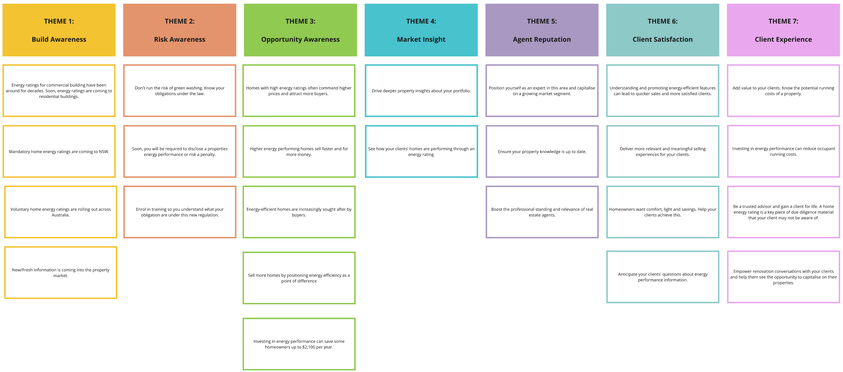
Participant insight voting by theme
3
Votes: 7
Votes: 0
Votes: 1
Votes: 7
Votes: 11
Votes: 2
Votes: 0
1
Votes: 0
Votes: 14
Votes: 1
Votes: 5
Votes: 3
Votes: 4
Votes: 2
2
Votes: 2
Votes: 5
Votes: 4
Votes: 2
Votes: 2
Votes: 12
Votes: 6
Votes: 4
Votes: 1
Votes: 3
Votes: 6

Slide 62
Roundtable resources & materials
Summary of materials used in research sessions
62

Slide 63
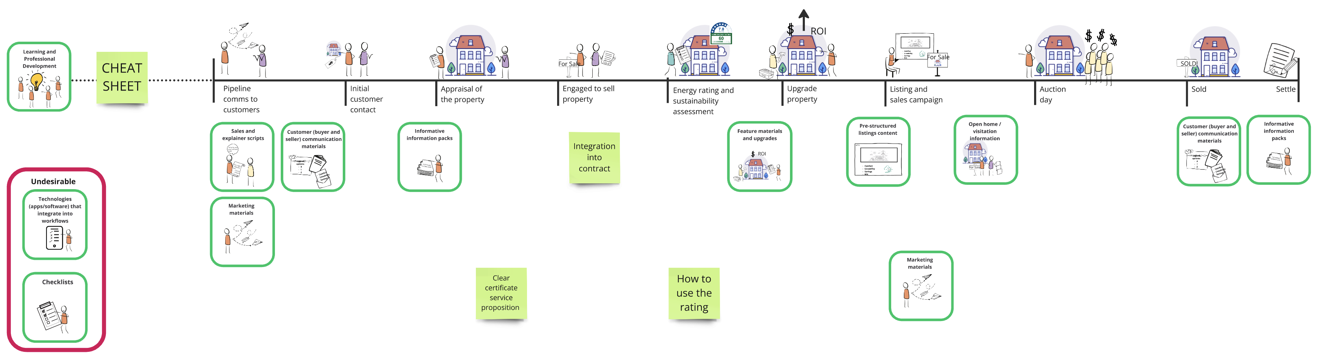
Resources and materials
Hypothetical resources and materials that could support the home energy rating process were tested with RE agents. RE agents positioned the resource types where and when they thought they would be most useful in a property sales journey. RE agents then built on what they would expect and like to see from these resources. Resources were not prioritised or ranked but were identified as key resources.
PREPARATION PHASE
ENGAGEMENT PHASE
FINALISE PHASE

Slide 64
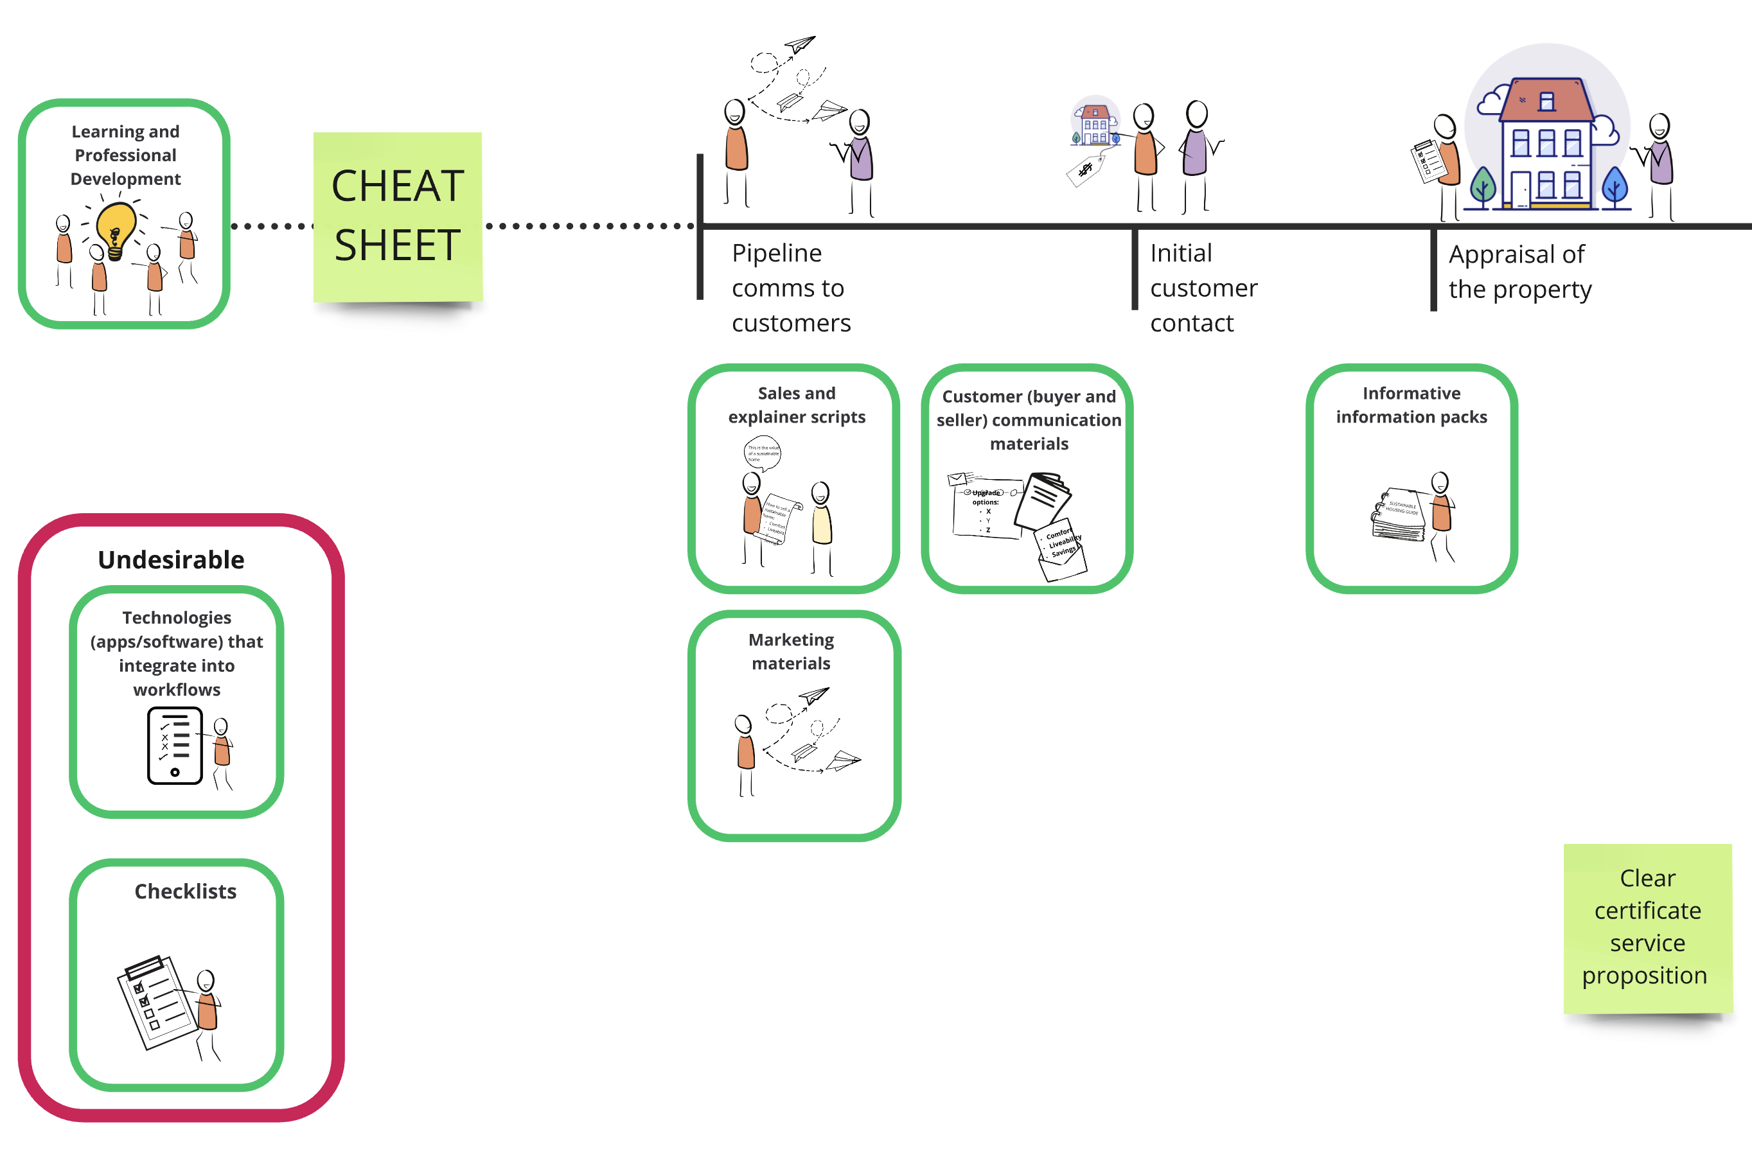
Preparation phase – 1
Proactive Education: Learning and professional development
Before any legislative requirements are introduced, real estate agents must be equipped with the knowledge and skills to navigate energy efficiency standards. Rather than relying on basic consumer brochures or reactive updates, agents need comprehensive yet concise educational resources that enable them. This proactive approach will build confidence and ensure agents are prepared to lead in a changing market.
Learning about it before it becomes legislated so you are ahead of the game. - RE agents Resources 1
Cheat sheet: Quick-reference guide for home energy ratings
A cheat sheet would provide real estate agents with concise, essential information about home energy ratings—what they are, how they are assessed, and what they mean. This quick-reference tool would be similar to past compliance guides, helping agents confidently answer questions and advise clients without needing to delve into lengthy documents.
A cheat sheet for us, like when we had to become smoke alarm compliant in Qld. Information for us: we need to know what the ratings are, what they mean, how they are assessed. - RE agents Communicating Ratings 1
Don’t give agents new tech instead integrate into existing
Rather than introducing new technologies, it's crucial to optimise existing tools to support home energy ratings. Real estate agents are already overwhelmed with software they barely utilise. So any new content or materials should integrate seamlessly with current CRM systems for ease of use, avoiding additional tech overload.
Do we really need any more tech?? we've got agents that don't even use 10% of what they have available in their office anyway. - RE agents Resources 2
Agents won’t do any extra paperwork but property managers might
Sales agents dislike paperwork, making checklists impractical for them. However, property managers and administrative staff, who are more compliance-focused, are better suited to handle checklist tasks related to home energy ratings, ensuring accuracy and adherence without burdening sales teams.
Checklists - agents detest paperwork. - RE agents Resources 2

Slide 65
Preparation phase – 2
Comprehensive information packs for home energy ratings
Information packs, similar to Fair Trading consumer guides, can be included in property appraisals and pre-listing kits to educate buyers and sellers about home energy ratings. These packs should clearly explain the purpose, impact on lifestyle, and next steps, making it easier for consumers to understand why energy ratings matter. If mandated, agents are more likely to integrate this information during the onboarding process.
Information packs need to be in the same style as the consumer guides from Fair Trading. Don't leave it up to someone else to explain. - RE agents Resources 1
Sales scripts and marketing materials for home energy ratings
Providing real estate agents with standardised sales scripts and consumer-focused marketing materials about home energy ratings would ensure clear and consistent communication. These tools would highlight the benefits to consumers, offering a compact yet detailed understanding. Standardised guides and disclosure documents from credible sources would increase transparency, allowing buyers to verify information independently while simplifying the agent’s role in educating clients.
Would be great to have scripts for the sales people. - RE agents Resources 2
If you've got a standardised consumer guide that says here’s what energy ratings mean for you, it comes from a credible source. I don't need to create one. - RE agents Resources 2
Certification process guide for home energy ratings
Establish a straightforward and transparent process for obtaining, renewing, and understanding home energy rating certificates. This includes clear guidelines on the certification steps, validity period, and consistent rollout to ensure reliability and trust in the rating system.
Ensure the certificate in properly rolled out in a clear way. - RE agents Resources 1

Slide 66
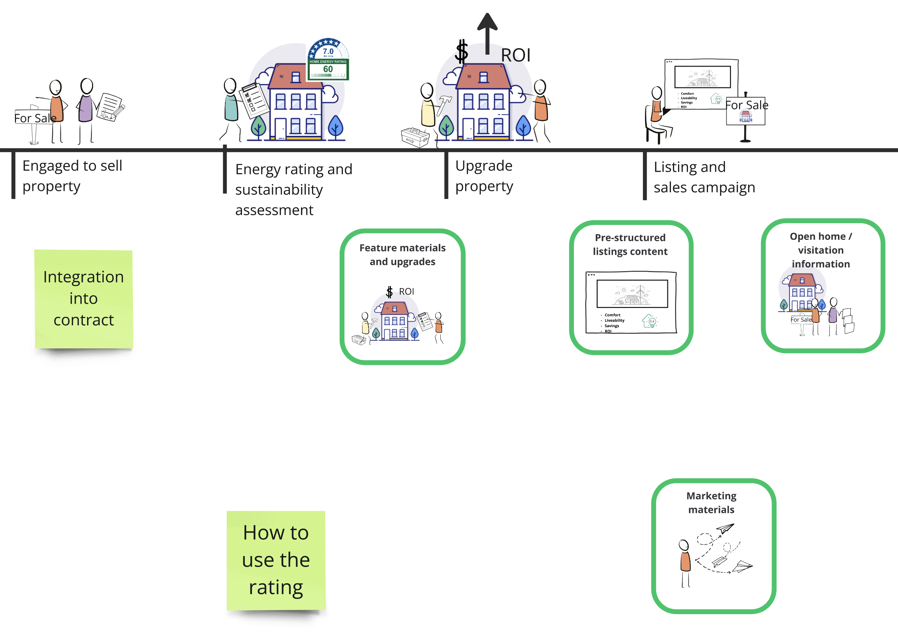
Engagement phase – 1
Integrating ratings certificate into property contracts
Embed home energy rating certificates into the property sale contract to formalise their role in transactions. This ensures legal accountability and allows solicitors to handle compliance while agents promote the ratings during listings. Flexible integration with appraisals or other stages of the sale process can streamline implementation.
It should be the solicitors role in the contract of sale. I don't think giving it to real estate agents is going to help anyone. Penalties go and make us to do stuff, but it should be in the contract of sale. Make sure agents have to promote it as part of their listing. - RE agents Resources 2
Property upgrade guidance
Providing a list of potential upgrades with clear return on investment could encourage sellers to include energy-efficient improvements during pre-sale preparations. However, agents believe such upgrades are unlikely unless the financial benefits are evident, as sellers typically prioritise changes that directly boost property value. RE agents believe a list of improvements is more likely to be actioned by the buyer.
Clear content and standardised resources for action
Agents require clear, standardised resources that explain how energy ratings impact a property’s value and relevance. Comparative data is essential to ensure the information is meaningful and actionable for both vendors and buyers.
“Agents will need very clear instructions on exactly what is relevant and how it impacts the home - standardised form needed or data will not be comparative to other homes and therefore less valuable to vendors and buyers” - RE agents Resources 1

Slide 67
Engagement phase – 2
Ready-to-use listing content
Provide pre-structured, copy-and-paste content aligned with energy rating certificates for easy integration into property listings. This ensures consistent and accurate messaging about a home's energy efficiency across listings.
Fact sheets for open home visitors
Provide clear and concise fact sheets for open home visitors to explain home energy ratings, their benefits, and potential upgrades. These materials should serve as an informative guide while directing buyers to expert resources for further details.
The factsheets are fundamentally giving all the info they can - but with a disclaimer that we aren't necessarily the experts -refer back to these suppliers. - RE agents Communicating Ratings 1
Marketing materials for buyer engagement
Equip real estate agents with tailored marketing materials that highlight the value of home energy ratings. These resources will help agents effectively communicate energy efficiency benefits, enhancing buyer understanding and interest. Materials might include brochures, leaflets, newsletters, or video explainers.

Slide 68
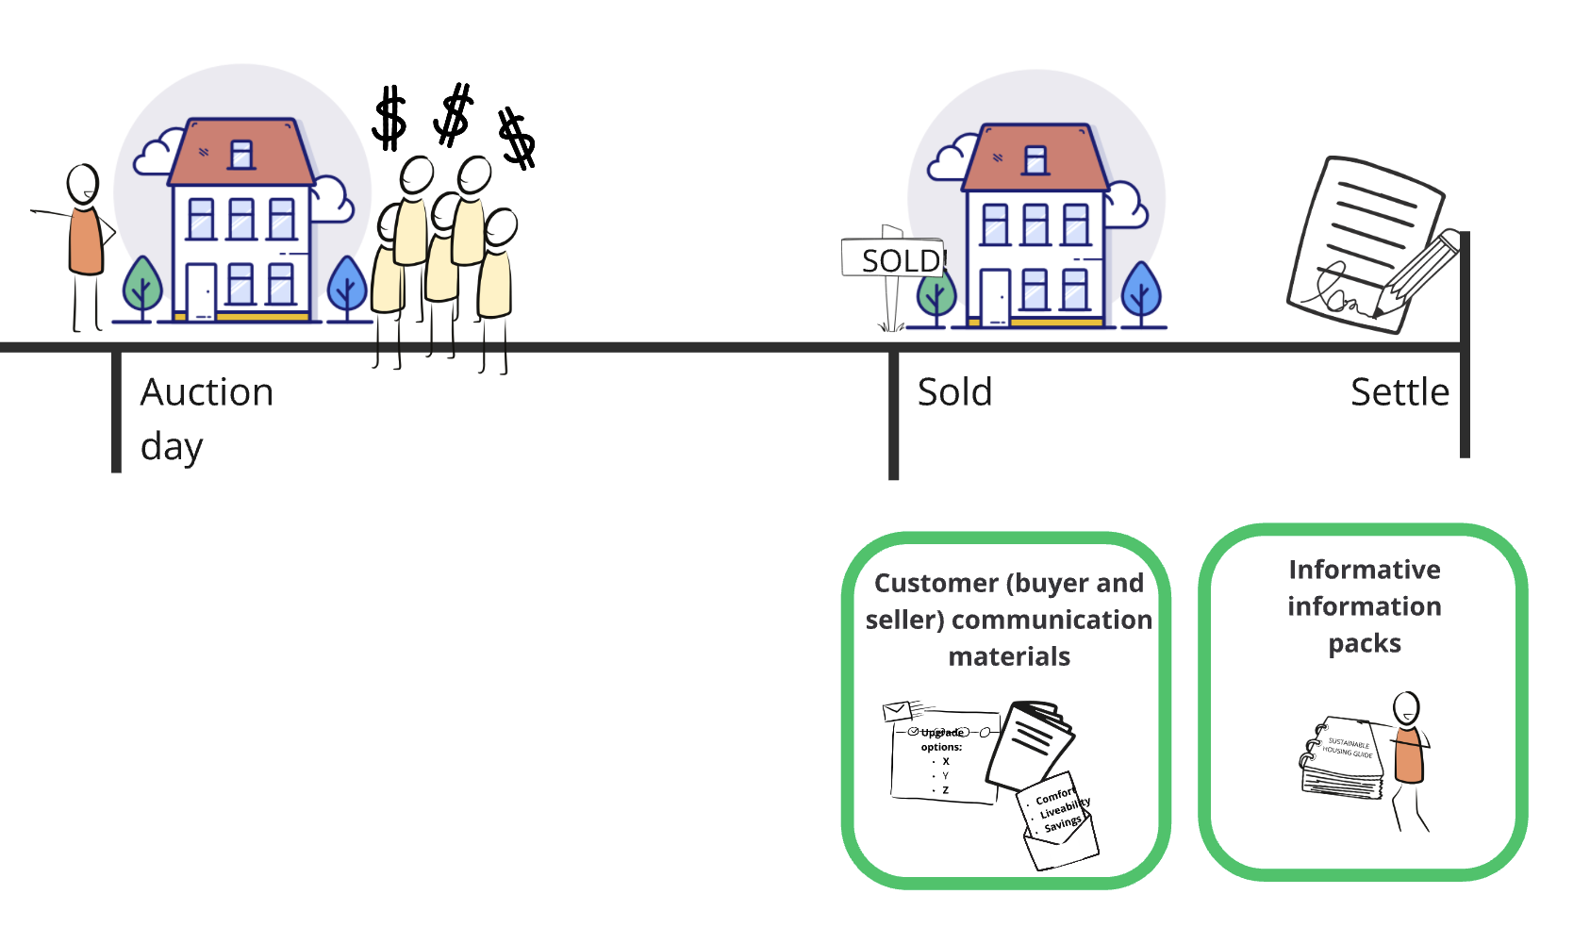
Finalise phase
Empower buyers with home energy insights
Develop targeted content for buyers to help them understand home energy ratings, ask informed questions, and leverage the information during negotiations. Provide guidance on upgrade options, government incentives, and actionable steps to improve energy efficiency after purchase, ensuring a seamless transition to a more sustainable home.
Buyer is also critical to this journey. Buyer not mentioned in this timeline. - RE agents Resources 1

Slide 69
Roundtable professional development and learning
69

Slide 70
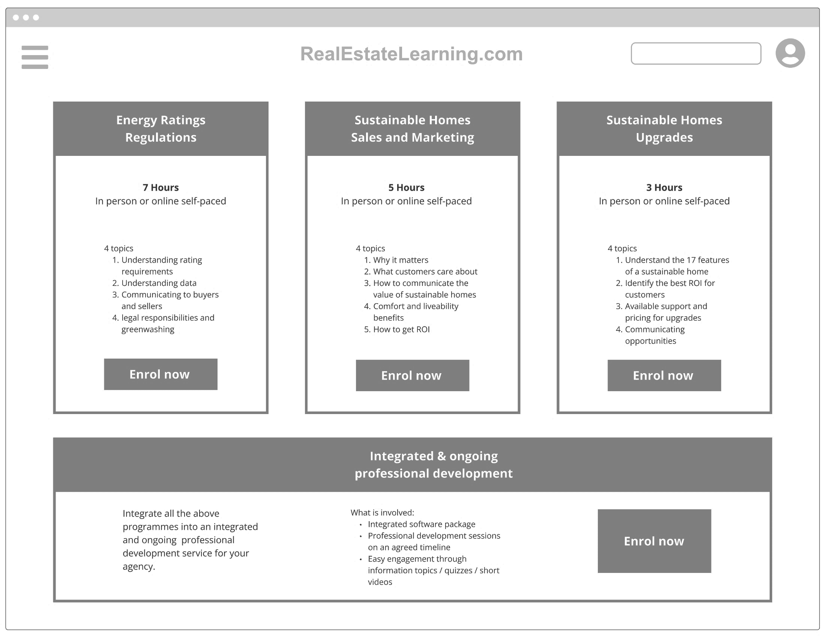
Professional development and learning
Professional development and learning opportunities were tested across two roundtables with participants.
Professional development was tested in the form of a course offering that might be found online. The mock-up displayed here was used to elicit discussion and reflection on what makes training and learning desirable or not.

Slide 71
Key findings – 1
The 3 learning topics resonated with RE agents
The proposed topics for training resonate strongly with RE agents. Many were particularly drawn to the topic of "Sustainable Homes and Marketing," seeing it as a way to distinguish themselves as trusted advisors. While energy rating regulations are seen as essential.
Agents appreciated the clear categorisation of topics into distinct "buckets"—Regulatory information, marketing strategies, building more expertise—highlighting the importance of separating compliance from opportunities to engage clients and build trust.
I love them all. - RE agents Upskilling 1
Energy rating regulations, that's your compulsory topic. But actually trying to appeal to this is about creating that differential and making you the trusted advisor is what I'd gravitate to. - RE agents Upskilling 2
In terms of the buckets, bang on. Separate out the technical and the regulations, from the marketing and sales. - RE agents Upskilling 1
RE agents expected regulatory training to be mandatory
RE agents anticipate that regulatory training on home energy ratings will be mandatory, mirroring existing continuing professional development (CPD) requirements like ethics. They emphasised that ensuring compliance with these regulations should be the first priority.
There is a strong belief that mandatory education is essential for agents to be properly equipped with the knowledge to guide clients, aligning it with other fundamental aspects of property knowledge. Many RE agents also noted the importance of a clear deadline for completing this training, ensuring industry-wide uptake and understanding.
You probably want highest uptake in regulations, and then upsell to the others. Just so people understand the regulation first and foremost, and aren't in breach. - RE agents Upskilling 1
Would expect it to be mandatory because there's mandatory CPD training we have to do all the timing. - RE agents Upskilling 2
If NSW is rolling out mandatory, the training should be mandatory too. - RE agents Upskilling 2

Slide 72
Key findings – 2
Training must be engaging to be effective
RE agents highlighted the importance of delivering home energy rating training through engaging and dynamic personalities to ensure high uptake. Trainers like Josh Phegan, Tom Panos, and Lee Woodward were suggested for their ability to captivate audiences.
RE agents stressed that combining experts with engaging speakers would keep interest levels high. The key takeaway is that content delivery should be compelling, fun, and interactive to prevent mandatory training from becoming monotonous and ineffective.
If it isn’t, some of the participants mentioned that RE agents could have assistants or admin staff complete mandatory training rather than using their time.
If it isn’t, RE agents will have assistants or admin staff complete mandatory training rather than using their time.
Whoever is delivering it is critical. Who are you going to train. Finding the trainers that are going to be compelling, interesting, engaging. - RE agents Upskilling 1
Underquoting training was mandatory and it was painful to sit through. - RE agents Upskilling 2
A lot of these mandatory courses are like pulling teeth. The people who offer it make it difficult to follow along because of how dull it can be. - RE agents Upskilling 2
Concise and self paced training is most desirable
RE agents prefer home energy rating training to be concise, with 3 to 4 hours being the ideal duration. For regulatory courses, agents recommended a maximum of 4 hours, with anything longer (e.g., 7 hours) seen as excessive.
When it comes to delivery, self-paced online courses were favoured by many, offering flexibility and efficiency. However, in-person sessions were still a preferred delivery format for a few participants. RE agents stressed that the training should be engaging, with a focus on practical, digestible content rather than lengthy webinars, as these can lead to disengagement.
3 hours. If I can get it done in 3 hours and not 7, then I'm doing that. - RE agents Upskilling 2
Online self paced is best, that's how a vast majority of people are trying to learn. But there are also people who think that in person is great. - RE agents Upskilling 1
Regs: I wouldn't make it more than 4 hours unless it's really complex. - RE agents Upskilling 1

Slide 73
Roundtable energy rating certificate
73

Slide 74
Certificate generation
Centralised pool of certificates and data for easy access and utilisation
The concept of a centralised repository for home energy ratings and certificates is seen as a valuable step towards improving accessibility and accuracy. A unified source of truth, ideally hosted by a government entity would streamline the data flow.
Linking back to government websites, where a centralised data lake could provide up-to-date information, would reduce the maintenance burden on individual websites. Additionally, having a certificate link in a central repository—provided by assessors—would allow seamless integration with property listings during the real estate marketing process.
It would be good for the CRMs to have that information that would be coming from the data lake. - Proptech 1
Maybe linking back to government sites where there's an energy link that goes back to that site which the data lake feeds into. - Proptech 1
Enabling Efficient Data Integration for Proptech
To make home energy rating data easily accessible for Proptech, a seamless integration strategy is essential.
Challenges and risks include transferring data from RE agents to CRMs to listings and advertising, which is at risk of being a manual and fragmented process.
Simplifying data collection through APIs or more structured formats like REA XML could alleviate friction. Leveraging AI for extracting key attributes could also improve efficiency, especially if data is sectioned in ways that's easy to analyse.
We have multiple systems and we don't want to have to build 6 transforms for that data. - Proptech 4
is there an API, how can we make it easy from a data collection perspective?
I'd love it if you made it an api, but the reality is it has to be an REA XML format. - Proptech 4
I'd say we would be looking at 90% of our integrations being REA XML. If that was included in the REA spec, we would have little problem feeding out to those providers. - Proptech 1
You are going to have a challenge in terms of getting the data from the assessor to the CRMs. That's another integration point, it's a very manual process. - Proptech 2

Slide 75
Energy Rating Certificate Feedback
As part of the RE agent Communicating Ratings roundtables and the Proptech Interviews participants had the opportunity to engage with and provide feedback on a ‘draft home energy rating certificate’ that was created for the consultation purpose.
The following pages are a summary of participant feedback.
75

Slide 76
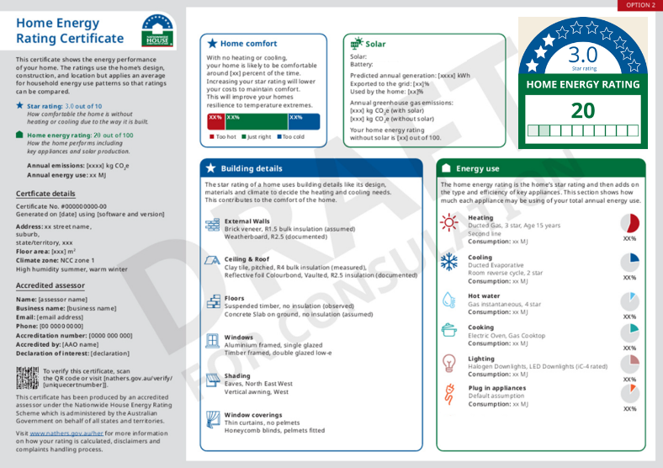
Energy Rating Certificate Feedback – Version 1
The overall level of information feels appropriate.
“It's clear, concise, really good as an overall. Comprehensive too. Struck me that this assessment that's going to be completed, there's a lot in it, lots of important information.”
DRAFT FOR CONSULTATION
As part of MVP listings kit / information provide icon as high quality Jpeg. So that the icon can be uploaded to listing images.
“Once a person goes out and certifies it, and produces a report, we'll need the reports, also a nice jpeg.”
On all materials ensure rating is expressed out of a total.
“Is 60 good or bad? I don't know.”
Refine how score and icon is expressed to make more sense to users:
Participants think the star rating is the most important rating and that it must be the energy rating used for disclosure purpose.
Participants saw green and assumed the rating was positive.
Separate the ratings to help reduce confusion.
“My initial thought is the higher the star rating, the more energy efficient the house is”
“When you've got multi scales its confusing.”
“Because the colour is green it implies that it's all good, as opposed to red.”
As an MVP consider making the certificate blurb the minimum text on a listing. Allowing users to copy and paste content.
“That looks like a standard result you get in terms of the blurb if you get 60/100. If you get a 61/100, do you get the same blurb? My assumption is that that is the standard blurb.”
Provide expiration date or triggers for recertification.
“The only other question is how long are these certificates valid for.’
Focus of the certificate should be on the physical dwelling.
“Why is plug in appliances there? That has nothing to do with the house? If someone has an energy inefficient fridge, why does the house get penalised for that. It shouldn't be wrapped up in the house energy rating. It has nothing to do with the physical house.”

Slide 77
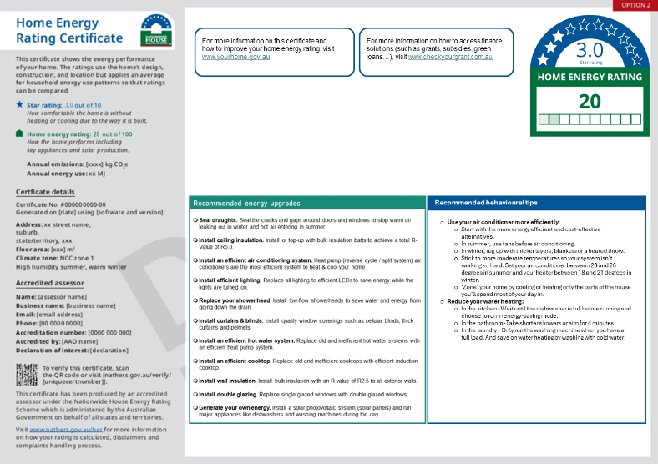
Energy Rating Certificate Feedback – Version 2
DRAFT FOR CONSULTATION
Contextual and relevant comparison is critical for user understanding. Consider a space for context specific information like:
Dollar figure savings on bills
Data on houses of a similar age
Data on houses in suburb/state
“The more practical and relevant information, the more helpful for consumers.”
“It's a disclosure point and people want a context point to make a decision.”
Refine how upgrades are communicated. Some upgrades like wall insulation or double glazing might feel overwhelming or scary whereas upgrading to LED lights or curtains and blinds are minor and achievable. Consider separating out different upgrade types.
“There are some easy things to do, and there are some more higher order things which are more difficult, more effort, invasive”
Maybe create a space for building specific assessor notes and information. This would be more preferable to generic behavioural information.
“Deeper property insights are important.”
“The recommended behavioural tips should go on a standardised document. The certificate should only include information about that dwelling.”
Find a way to show what impact each upgrade will have on the home rating so that users can make more informed choices.
“If you've got a 2 star energy rating, you want to know if you engage the builders that it will actually take you to a 3 star”

Slide 78
Roundtable Communicating Listings
78

Slide 79
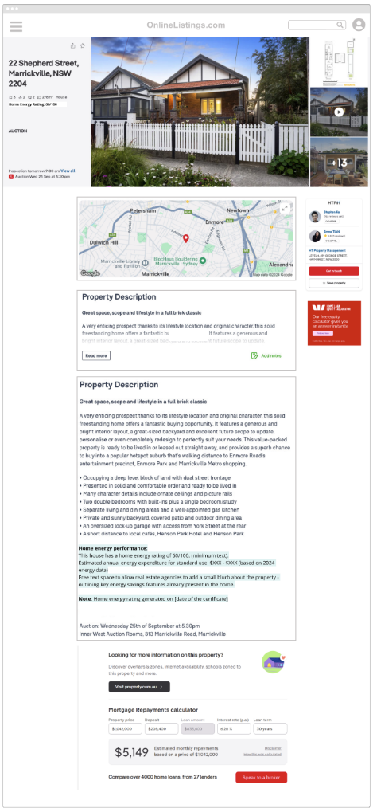
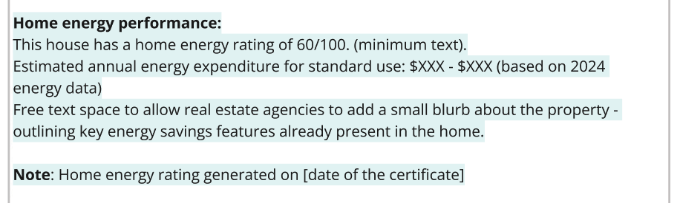
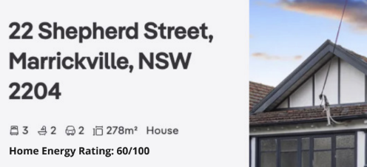
MVP Listing
Mock-up listings were tested as part of the listings Proptech interviews to elicit the feasibility, viability and desirability of how and where an energy rating might be disclosed to consumers.
The example to the right is an minimum viable product (MVP) mock-up, building on how the ACT already disclose energy ratings.
An MVP style listing disclosure is feasible and viable for key Proptech stakeholders.
Because of the adoption of disclosure by the ACT, many of the fields and structures required to disclose a Home Energy Rating across other states already exists. It would take minimum adaption by Proptech stakeholders to integrate and MVP disclosure.
But a more prominent disclosure might be more desirable.
Many Proptech participants noted that although this MVP is achievable, it will probably not have the desired impact on consumers. Many Proptech providers suggested disclosure should and could be more prominent than MVP.
Text based disclosure is straight forward but could be improved.
Providing the home energy rating as free form text within the listings description is the lowest barrier to disclosure but still has risks.
Participants noted a free form approach will create inconsistencies for consumers in how ratings are communicated putting the effort on consumers to interpret and compare ratings.
Additionally compliance might be low out of fear of getting the description wrong or potential greenwashing.
To combat this, a set and predefined copy and paste description or text might be made available as part of the certificate for RE agents to copy into descriptions. Additionally industry standardisation and automation would reduce these risk for the majority of RE agents.
“What you've got now is fairly light touch and should be in all the CRMs.”
“where that creates concern for me is that it should be prominent, not obscured. Putting it in the property description is not a way to keep it prominent.“
“Having it in the property description isn't great from an advertising perspective.”
“The way the MVP looks, if you just wanted the text as is, that would be fine with our CRM.”
Home energy rating as part of main listings card.
Providing the home energy rating as part of a properties key information set on online listings was desirable, feasible and viable for Proptech stakeholders.
The only consideration is how this data is then presented on other forms of advertising like window cards, leaflets and display boards. This is feasible but will require design work to achieve the right outcomes in a desirable way.
“It's already in our system and the CRMs that feed us information, so the MVP for that is good.”
“Whatever the rating looks like, it has to be fit for purpose for portals, advertising, social media tiles, and the tools for property marketing.“

Slide 80
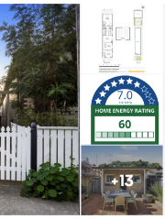
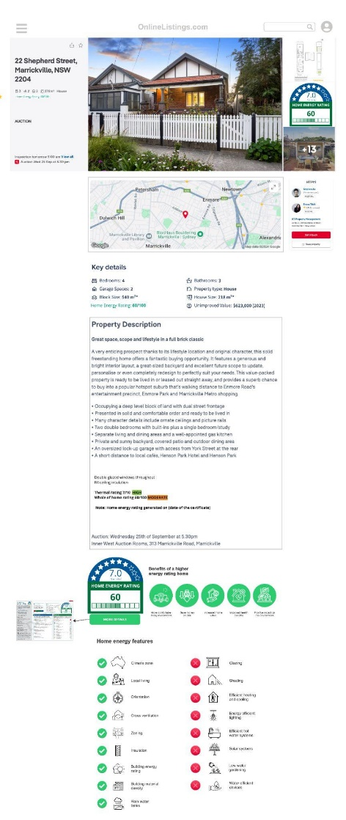
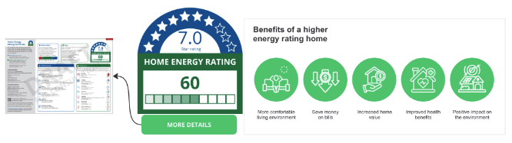
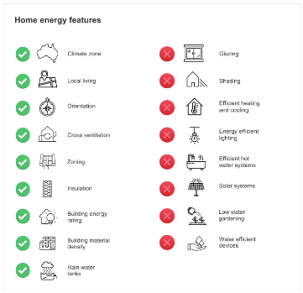
Future Listing
The mock-up example to the right was used to explore a possible future listing that has the home energy rating further integrated into the listing and more prominently displayed to users. The future listing build on top of what was already included in the MVP.
This disclosure model felt more aligned with the expectations of Proptech stakeholders, as it delivers more prominently the rating to consumers but would require more effort than MVP.
A key point of consideration for Proptech is the balance of disclosure rules with the flexibility to provide a user experience that aligns with their brand whilst also balancing the interests of their business, the buyer, vendor and real estate agent.
“I think that would be well received by the consumer, that's a good level of information and a good approach.” - Proptech 1
“Something like this is more appealing. Visually clearer to see, more consumer orientated.” - Proptech 3
Low touch, you would think you would be able to get it up in a couple of months, it's not groundbreaking long term work. - Proptech 6
Home energy rating image as MVP option
If a Jpeg is provided as part of the rating ‘kit’ or certificate, adding the dwelling rating to the listing images is an easy and effective way to prominently disclose the rating.
Many Proptech stakeholders suggested this could be done as an MVP version.
“I can see how you have the rating in the image, that's not an issue we can do that right now.”
A standalone energy rating section makes future sense
A standalone section gives the home energy rating prominent disclosure and better enables buyers to make informed decisions. A stand alone rating space also unlocks potential commercial opportunities for Proptech with banks, loans companies and trades. It will be up to Proptech to define how the space is used to balance different user needs and priorities.
It may make sense to provide access to the energy rating certificate at this point so that potential buyers can understand the home details and features. Disclosing the certificate made sense to stakeholders and is feasible and viable for Proptech.
Further testing will be needed to understand if the listing is the best place for disclosing the report. Some think it makes sense while others though it should be disclosed as part of the property contract.
“When it says more details, does it open up to the certificate? I think it would be a miss if you didn’t do that.”
‘The data must be presented, and the certificate, and the icon. Make it clear what our job is. Document upload is another job for us, and we're happy to do it, but make it clear and document what we need to do, how we need to ingest it for the consumer. Because it doesn't say here is the document download a nice to have, or is it mandatory?”
Prominent feature list is valuable but more contentious
Protech stakeholder could see the value of disclosing features to users but felt negative indicators would create tensions with vendors and RE agents. This detail might be better left on the certificate.
“Having the home energy rating, logo and iconography, that's something they would live with. but the energy features underneath would be problematic.”

Slide 81
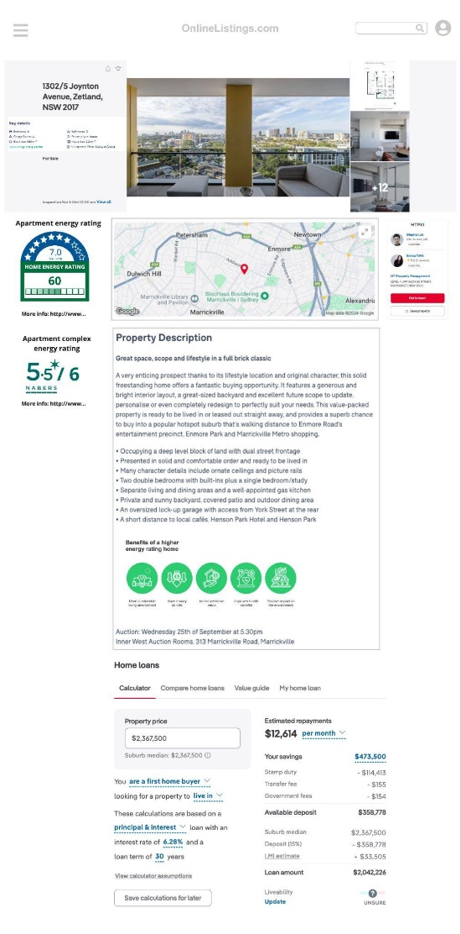
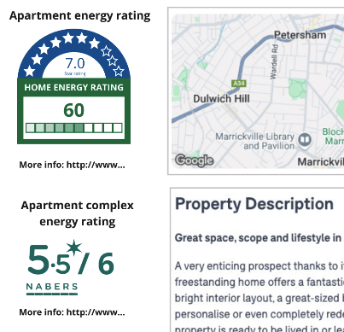
Dual Listing
The dual listing mock-up tested an apartment scenario which may require both the home energy rating and the NABERS rating to be disclosed.
Having multiple ratings disclosed creates confusion
Not only does the current home energy rating icon have 2 ratings on it that already cause confusion, adding an additional rating such as NABERS will further confuse users. Leading them to dismiss and disengage from the potential value of a rating.
Ideally ratings should follow a system of progressive disclosure, with the most immediate and important information available to users first and subsequent less immediate information available later. Participants indicated that it might be better to disclose NABERS on the strata report as it is more relevant there.
“Looks a bit messy, and then you've got to explain what an apartment rating is, what a NABERS rating is.”
“Why wouldn't put it in one module so that you've got the energy rating and NABERS rating side by side in one package”
“Ideally not two ratings for consumers - creates confusion, especially when bringing something new into the market.”

Slide 82
Thank you
NSW DCCEEW Team:
sustainability@environment.nsw.gov.au
Biome Studios:
Oliver Dykes
oliver@biomestudios.com
www.biomestudios.com
82

